Slide 1
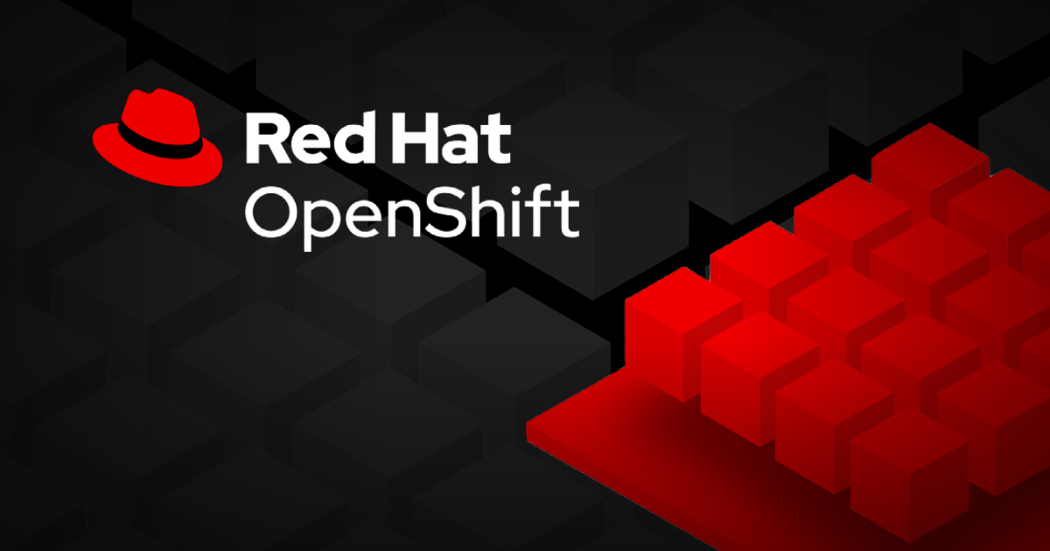
4. Deploy Managed and Networked Applications on Kubernetes

Slide 2
Deploy Applications from Images and Templates
1. Deploying Applications
• Kubernetes manages applications as collections of resources, which are eventually created and managed by the cluster. Red Hat OpenShift Container Platform (RHOCP) simplifies application deployment by using additional resources and tools like templates.
2. Resources and Resource Definitions
• Resources define components like pods, services, or deployments. YAML is commonly used to manage resources, and you can create, edit, or delete resources through commands like oc create or oc delete.
3. Templates
• Templates are YAML manifests containing parameterized resource definitions. They are processed with the oc process command, generating resources like services, persistent volume claims, and deployment configurations. Templates can also be used with oc new-app to create applications.
4. Pods
• Pods are the smallest compute unit, running one or more containers that share resources. The pod specification includes details like container images, environment variables, and ports.
5. Deployments
• Deployments manage the desired state of a pod, ensuring a specified number of replicas run at all times. They are more modern and flexible compared to replication controllers.

Slide 3
Deploy Applications from Images and Templates
6. Projects
• Projects in OpenShift are enhanced Kubernetes namespaces used to organize and manage access to resources. They allow Role Based Access Control (RBAC) for managing user permissions.
7. Services
• Services allow communication between pods using labels to route requests. They expose a stable IP address and port, enabling pods to access each other within the cluster.
8. Persistent Volume Claims (PVCs)
• PVCs request storage for a pod. They bind to Persistent Volumes (PVs), which are globally scoped, while PVCs are namespaced.
9. Secrets
• Secrets store sensitive data like passwords or credentials. These can be mounted into pods or used to declare environment variables.
10. Imperative vs Declarative Resource Management
• Imperative commands like oc create or oc run directly instruct Kubernetes to create resources, while declarative commands, like oc new-app, specify the desired state of resources for the cluster to match.
11. Retrieving Resource Information
• Use commands like oc describe to view details about resources, and oc get for structured output like YAML or JSON.

Slide 4
Manage Long-Lived and Short-Lived Application by Using Kubernetes Workload API
1. Kubernetes Workload Resources
• The Kubernetes Workloads API manages various tasks and workloads using resources like Jobs, Deployments, and Stateful Sets. These resources help automate and manage containerized applications.
2. Jobs
• A Job resource executes a one-time task via pods and retries the task if a pod fails. Jobs are useful for tasks like database initialization or backup creation. Example: oc create job date-job --image registry.access.redhat.com/ubi8/ubi -- /bin/bash -c "date".
3. Cron Jobs
• Cron Jobs extend jobs by running tasks at scheduled intervals, defined by a cron-like schedule. They are commonly used for periodic tasks like backups. Example: oc create cronjob date-cronjob --image registry.access.redhat.com/ubi8/ubi --schedule "*/1 * * * *" -- date.
4. Deployments
• A Deployment manages pod replicas through a ReplicaSet to ensure a specified number of pods are running. Deployments automatically replace failed pods, making them ideal for long-running applications. Example: oc create deployment my-deployment --image registry.access.redhat.com/ubi8/ubi --replicas 3.

Slide 5
Manage Long-Lived and Short-Lived Application by Using Kubernetes Workload API
5. Labels and Selectors
• Labels are key-value pairs used to categorize resources. Selectors filter resources based on labels, allowing commands to target specific resources. Example: oc delete pod -l environment=testing.
6. Stateful Sets
• Stateful Sets manage unique, stateful pods. Each pod has a unique identity, making stateful sets ideal for applications requiring persistent storage or network identity. Stateful sets ensure stable, predictable pod behavior.

Slide 6
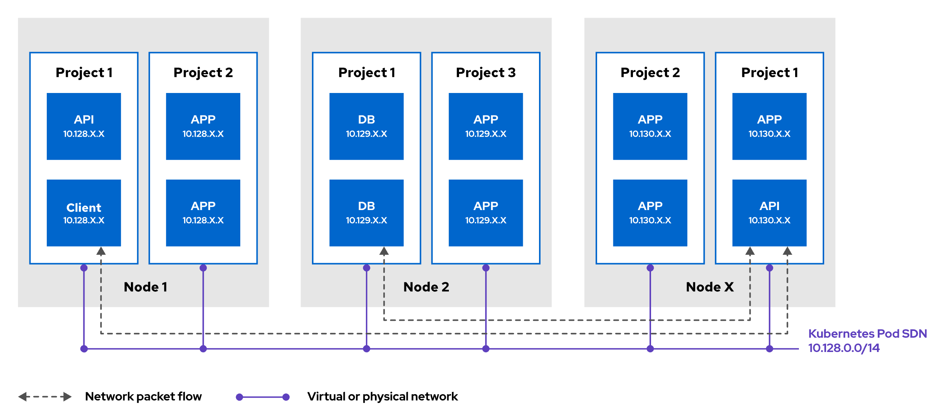
Software-defined Network
Fig 1: How the Kubernetes SDN manages the network
Kubernetes uses Software-Defined Networking (SDN) to manage network infrastructure within the cluster. The SDN acts as a virtual network connecting all cluster nodes, enabling communication between pods and containers. While accessible to processes managed by Kubernetes pods, the SDN is isolated from external access and regular node processes. SDN allows programmatic control of network traffic and resources, supporting traditional networking methods like IP address leasing and port allocation. It also facilitates the containerization of legacy applications by maintaining seamless communication across services that use TCP/UDP protocols.

Slide 7
Kubernetes Networking
- Kubernetes networking enables scalable communication between containers, providing various capabilities:
• Container-to-container communication within the same pod.
• Pod-to-pod communication across different nodes or namespaces.
• Pod-to-service communication, allowing stable access to pods through services.
- Kubernetes assigns an IP address to every pod, but these addresses are unstable due to the ephemeral nature of pods, which are frequently created and destroyed. All containers in a pod share the same IP and MAC address, communicating via localhost.
- Pods can communicate across nodes and namespaces because they are assigned unique IPs within a shared, flat networking namespace. All pods exist within the same subnet, allowing communication without Network Address Translation (NAT).
- Kubernetes also uses a service subnet, where each service has a stable IP address linked to specific pods. This enables transparent traffic forwarding and dynamic load balancing without changing port or network configurations.
- By treating pods like virtual machines, Kubernetes simplifies port allocation, service discovery, and migration, with the SDN managing all networking infrastructure.

Slide 8
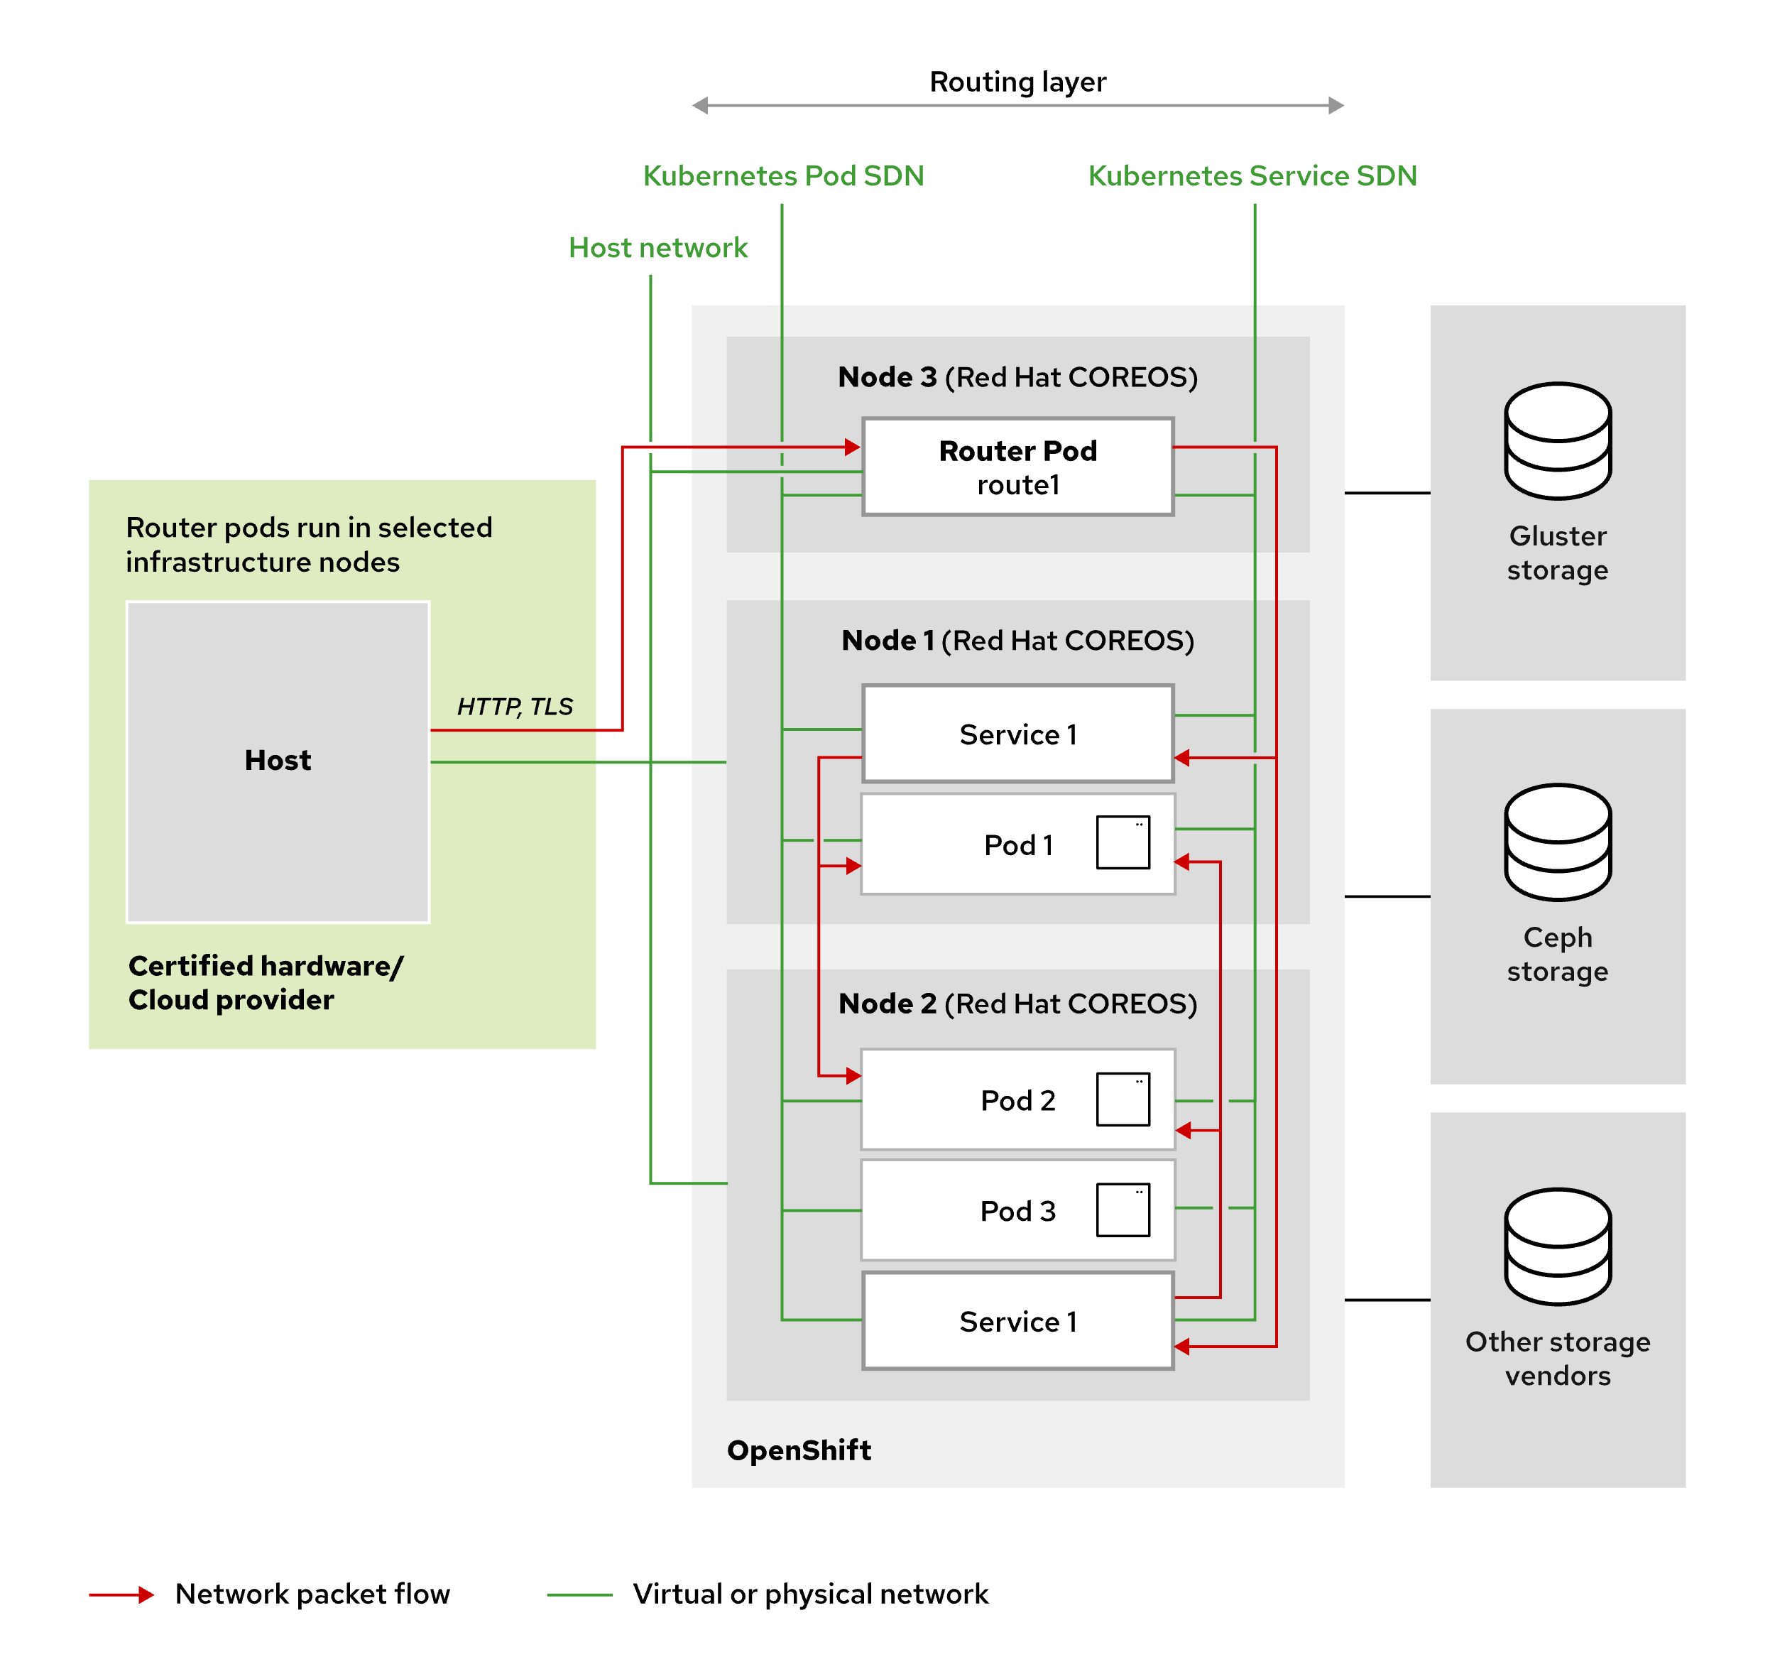
Kubernetes Networking
The shared networking namespace of pods enables a straightforward communication model. However, the dynamic nature of pods presents a problem. Pods can be added on the fly to handle increased traffic. Likewise, pods can be dynamically scaled down. If a pod fails, then Kubernetes automatically replaces the pod with a new one. These events change pod IP addresses.
Fig 2: Network Access between pods in a cluster

Slide 9
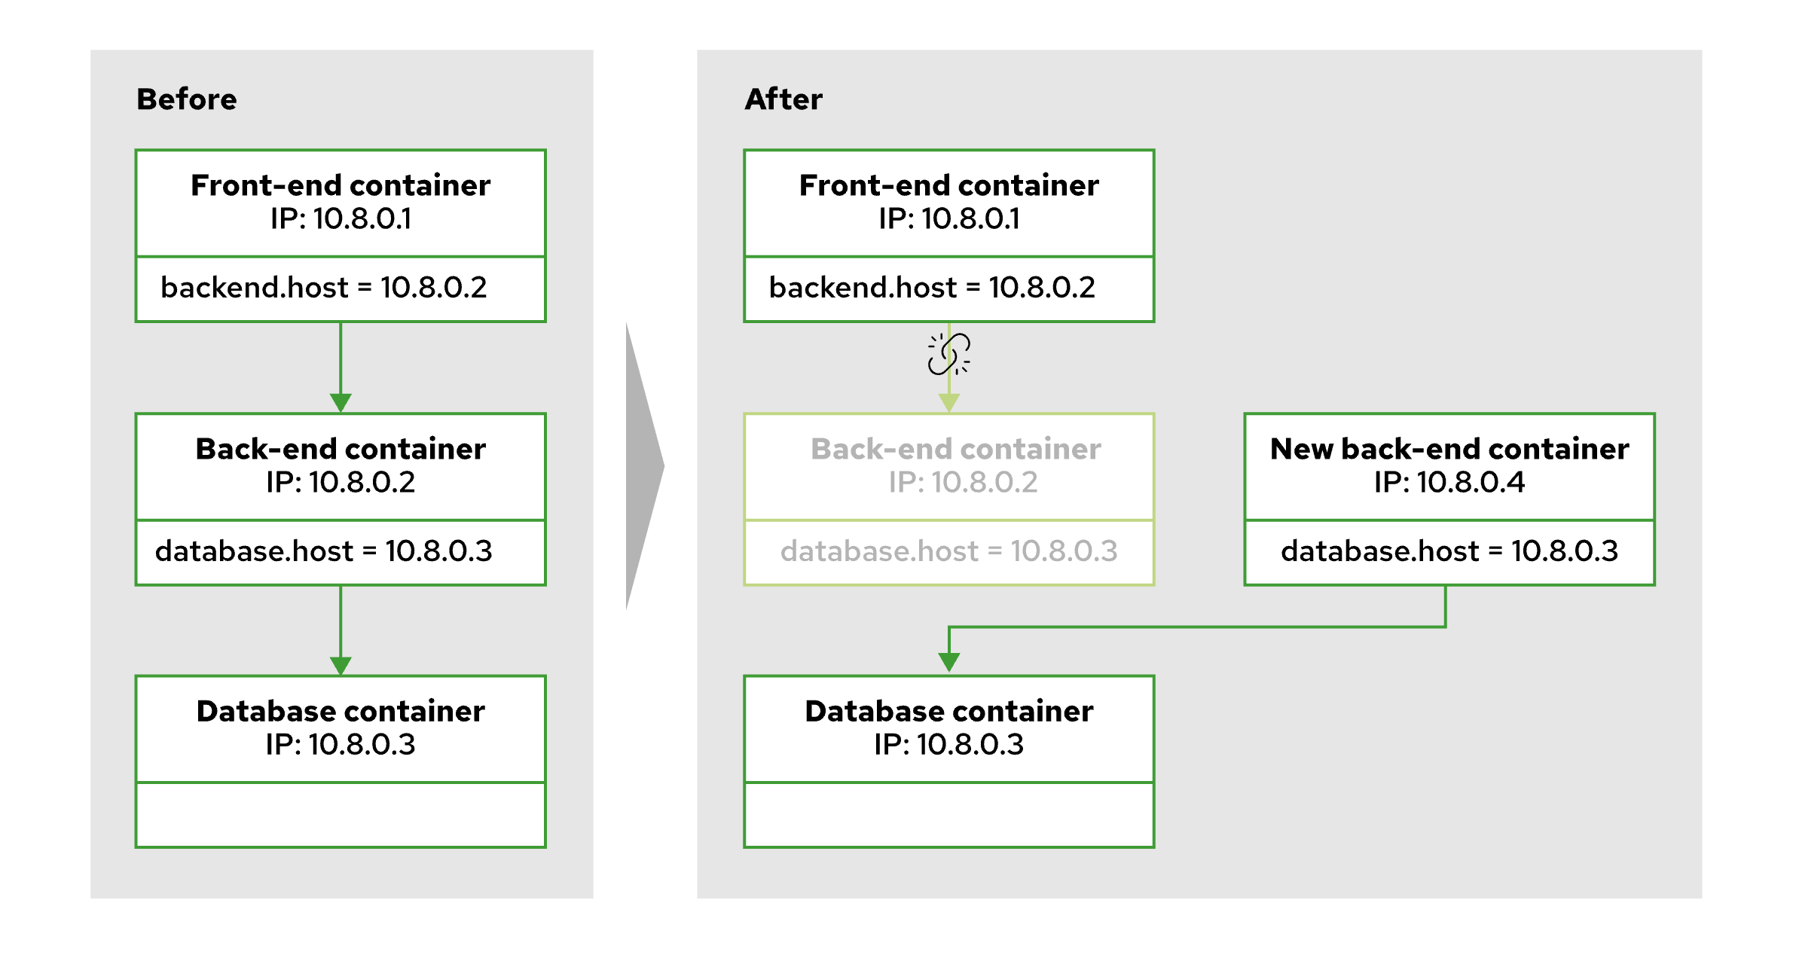
Direct Access to Pods
Fig 3: Problem with direct access to pods
- In the diagram, initially, the Front-end container (running in a pod with IP 10.8.0.1) communicates with a Back-end container in a different pod with IP 10.8.0.2. If the Back-end pod fails, Kubernetes automatically creates a new pod for the Back-end container, but it gets a new IP address (10.8.0.4). As a result, the Front-end container’s reference to the old Back-end pod (10.8.0.2) becomes invalid.
- Kubernetes solves this issue using service resources. Instead of referencing the pod’s dynamic IP, the Front-end container communicates with a stable IP assigned to a service, which is linked to the Back-end pods. This ensures seamless communication even when pods are recreated or their IPs change.

Slide 10
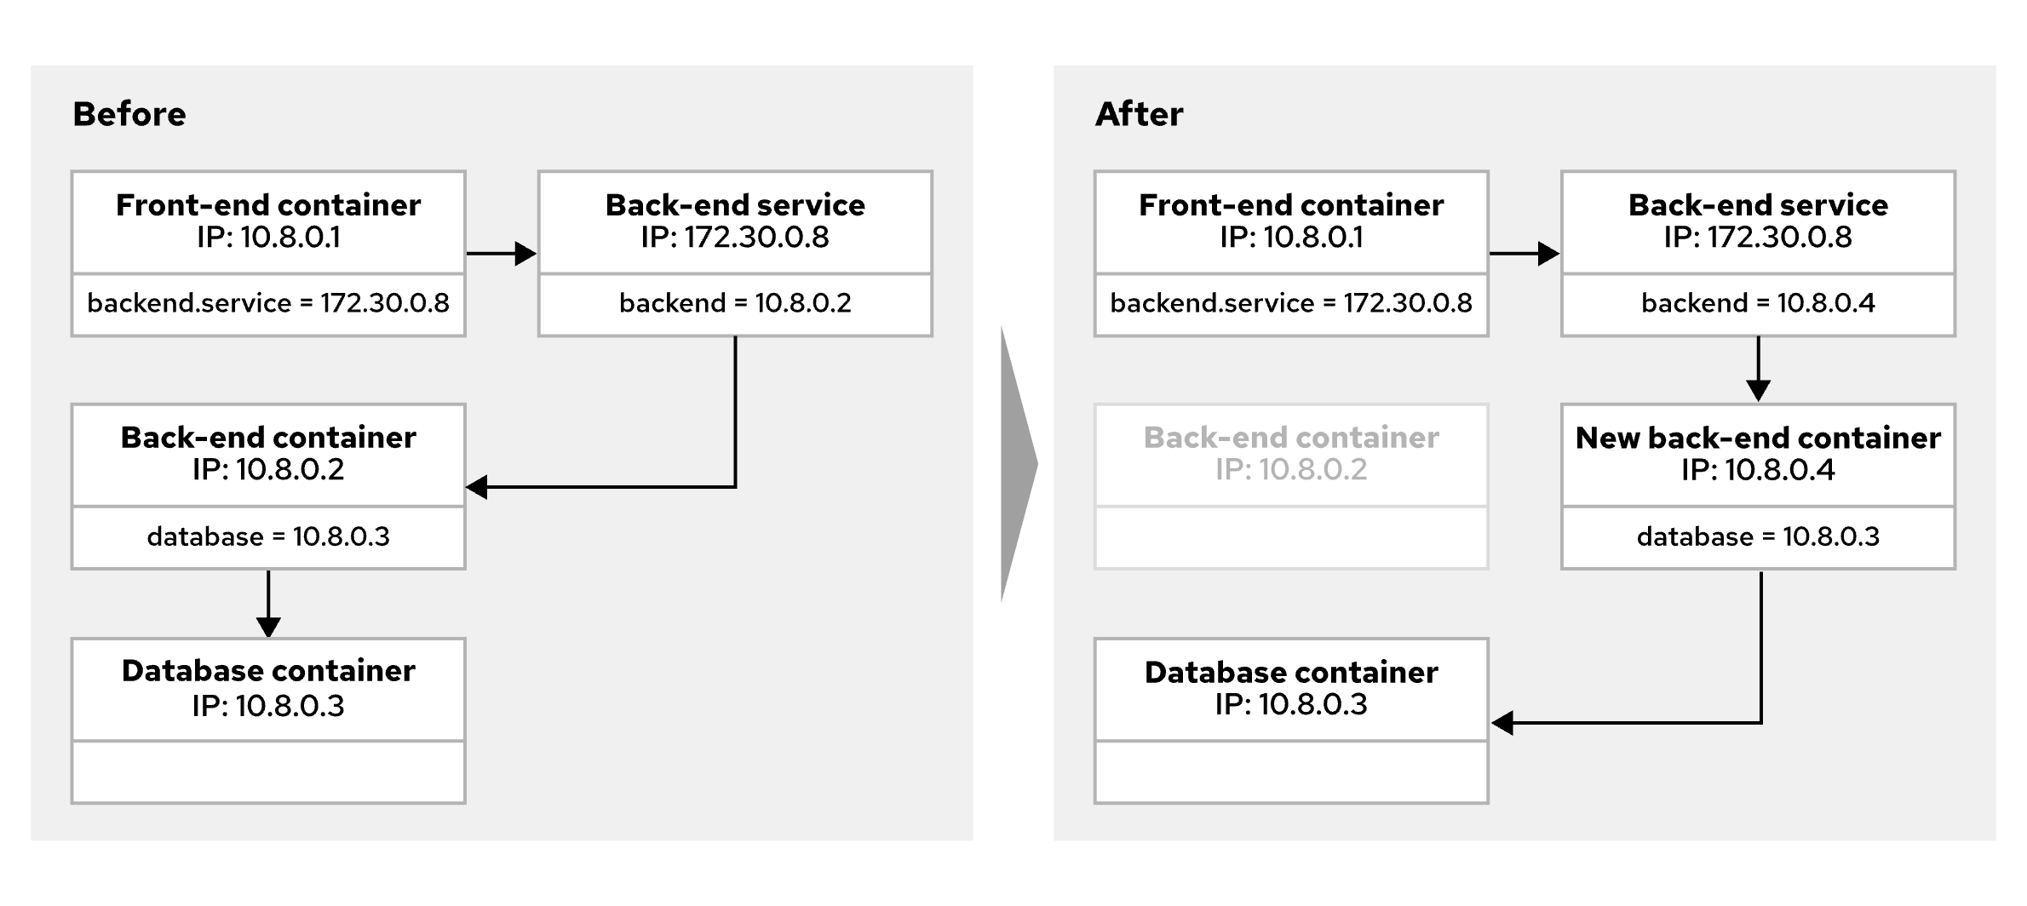
Using Services
Fig 3: Services resolve pod failure issues
Kubernetes assigns a stable IP address to a service resource, which is linked to a group of pods. This service acts as a virtual load balancer, ensuring that traffic is directed to the appropriate pods.
If pods are restarted, rescheduled, or replicated, the service endpoints are automatically updated. This ensures scalability and fault tolerance, as the service provides a permanent, static IP address that remains constant, even if the underlying pods are recreated. For example, a Front-end container uses a stable IP address to communicate with the Back-end service rather than directly with the Back-end pod’s IP. If the Back-end pod fails and is replaced, Kubernetes updates the service with the new pod’s IP, ensuring uninterrupted communication.

Slide 11
Using Services
Key Benefits:
• Stable IP Address: Services provide a consistent IP address for a set of pods, even when pods change.
• Load Balancing: A service can load balance traffic across multiple pods running the same application.
• Scalability: When applications scale horizontally with multiple pods, the service distributes requests to available pods, regardless of their physical location in the cluster.
• Simplified Communication: Services allow containers in different pods to communicate without worrying about changes in pod IPs or discovering new IPs after restarts.

Slide 12
Service Object and Pod Communication in Kubernetes
Scaling Applications with Kubernetes Services
In real-world applications, horizontal scaling is essential. Applications typically run across multiple pods to meet growing demand. A Deployment resource manages these multiple pods running the same container. To ensure seamless access and load balancing across these pods, Kubernetes uses a service, which provides a single stable IP address for the entire set of pods.
Services allow containers in one pod to connect to containers in another pod, regardless of whether they are on the same node, namespace, or project. The service ensures that a pod doesn’t need to discover new IP addresses after another pod restarts, as the service provides a stable IP address throughout the lifecycle of the pods.
Labels and Selectors:
Kubernetes uses labels to identify which pods are associated with a service. A selector in the service object matches specific key-value labels on the pods.
For example, if the service’s selector is app: myapp, only pods with the label app: myapp will be included in the service. These labeled pods form the endpoints for the service, meaning any requests to the service’s stable IP will be directed to one of the pods with the matching label. This mechanism ensures proper routing and load balancing.

Slide 13
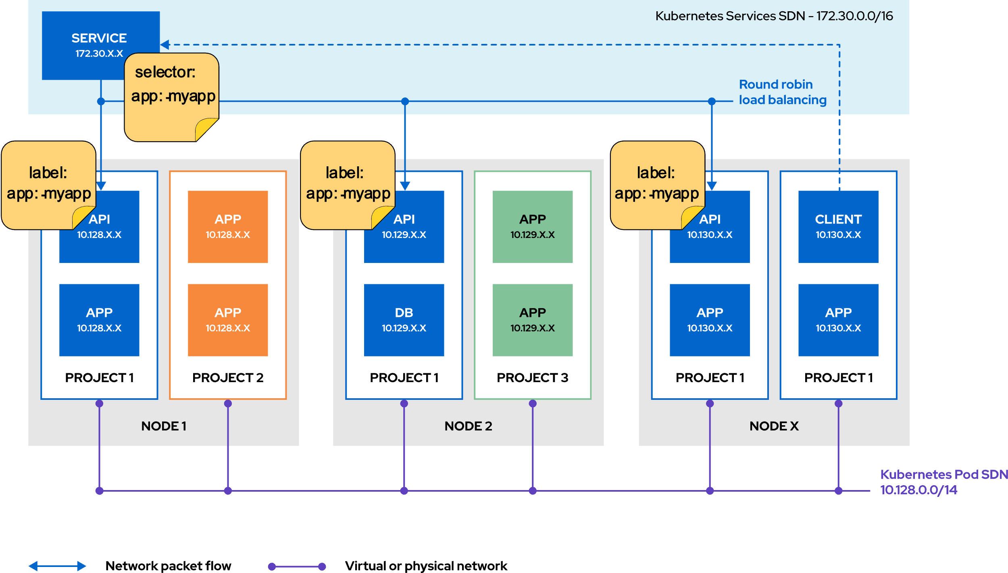
Service Object and Pod Communication in Kubernetes
Fig 4: Service selector match to pod labels

Slide 14
Creating a Service for Deployment in Kubernetes
To create a service in Kubernetes for a deployment, one use the oc expose command. This links the service to deployment and assigns it a stable IP address for communication. One can specify options like a selector (to match specific pods), the port for the service, the target port on the pods, and the protocol. If not specified, defaults are used (such as the protocol being TCP). The service enables stable communication with your pods by load balancing requests to the underlying pods that match the service.
The service allows pods within the same cluster to communicate via the stable IP, even when the underlying pods are restarted or rescheduled to different nodes.
Kubernetes DNS for Service Discovery
Kubernetes has an internal DNS server (CoreDNS), which automatically assigns a Fully Qualified Domain Name (FQDN) to each service. This FQDN follows the pattern SVC-NAME.PROJECT-NAME.svc.CLUSTER-DOMAIN. This system enables pods within the cluster to communicate with services using their DNS name rather than dynamic IPs.
The DNS operator ensures that each pod is provided with proper DNS configurations, so they can resolve service names and connect to other pods without worrying about underlying IP changes.

Slide 15
Creating a Service for Deployment in Kubernetes
Kubernetes Networking Drivers (CNI)
Kubernetes uses Container Network Interface (CNI) plug-ins to manage networking within the cluster. These plug-ins define the connection between the network provider and the container runtime, ensuring seamless communication among containers across nodes. Key CNI plug-ins include:
• OVN-Kubernetes: The default networking plug-in for OpenShift (RHOCP) 4.10 and beyond. It uses Open Virtual Network (OVN) and Open vSwitch (OVS) to manage the network configuration across the cluster.
• OpenShift SDN: An older plug-in from OpenShift 3.x that may lack compatibility with newer features.
• Kuryr: A plug-in tailored for OpenStack deployments.
OpenShift Cluster Network Operator (CNO)
The Cluster Network Operator (CNO) manages the configuration of OpenShift’s cluster networking, handling the deployment of CNI plug-ins. It allows the cluster administrator to configure and monitor the networking setup, including the ranges of IP addresses assigned to both pods (Cluster Network CIDR) and services (Service Network CIDR).

Slide 16
Scale and Expose Applications to External Access
Exposing Applications to External Access
• Objective: Use Kubernetes Ingress and OpenShift routes to allow external clients access to applications running in a cluster.
IP Addresses for Pods and Services
• Applications usually need horizontal scaling, with multiple pods running. Kubernetes services provide a stable IP and load balancing, abstracting dynamic pod IP addresses. This ensures scalability and fault tolerance as pods are restarted or rescheduled.
Service Types
1. ClusterIP: Default type, accessible only within the cluster, used for internal pod communication.
2. Load Balancer: Provisions an external load balancer, exposing services to the internet. Suitable for cloud environments but requires careful security considerations.
3. NodePort: Exposes the service on a static port on the node IP, but is less secure as it requires direct network access.
4. ExternalName: Maps to an external DNS name, returning a CNAME record for external resources.

Slide 17
Scale and Expose Applications to External Access
Using Routes for External Connectivity
• Routes expose applications to external networks, allowing external access via a public hostname. They use the ingress controller to direct traffic to pods. Routes provide additional features like TLS termination and blue-green deployment.
Ingress Objects for External Connectivity
• Ingress resources handle external HTTP, HTTPS, and SNI requests. They are similar to routes but offer minimal features, often relying on the ingress controller for TLS and session management. In OpenShift, routes are preferred over ingress objects.
Sticky Sessions
• Sticky sessions ensure that client requests always reach the same pod by using cookies to maintain session persistence. OpenShift allows configuring sticky sessions for both ingress and route resources.
Load Balancing and Scaling
• Kubernetes services function as internal load balancers, distributing traffic among replica pods. Scaling can be manual (e.g., using the oc scale command) or automatic. Routers detect service IP changes and update their configuration accordingly, balancing traffic across pods efficiently.

Slide 18
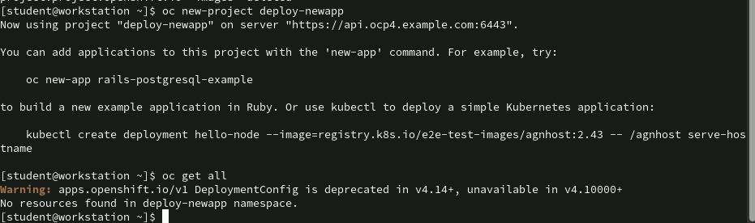
Command to create a new Projects and checking for Resources: oc new-project run
oc new-project deploy-newapp: This command creates a new project (namespace) in OpenShift called deploy-newapp.
oc get all: This command lists all resources in the currently active project (deploy-newapp). The command returns No resources found in deploy-newapp namespace, meaning no pods, services, deployments, or other resources have been created in this project yet.

Slide 19
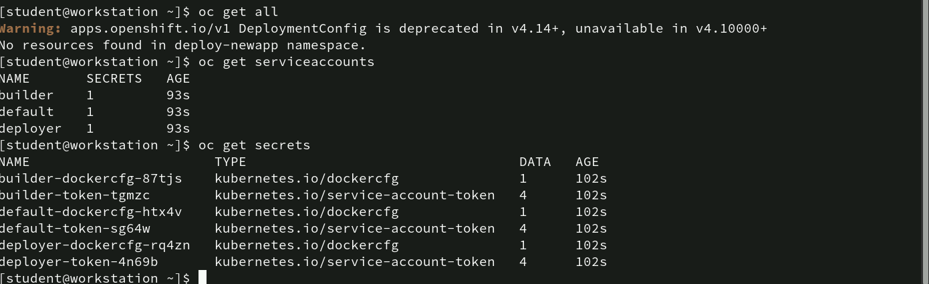
Commands listing service accounts and secrets : oc get
oc get serviceaccounts: This command lists all service accounts in the deploy-newapp project. The output returns builder(to build container images), default(services that don’t specify a service account), deployer(used for deploying applications). Each service account has 1 secret attached, and all were created 93 seconds ago (indicating that they are newly created).
oc get secrets: This command lists all secrets in the deploy-newapp project.

Slide 20
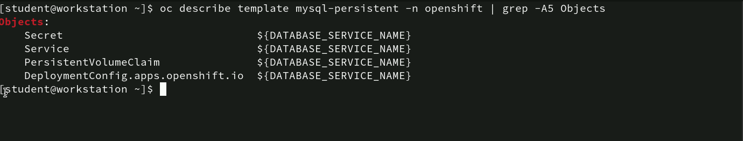
Commands to describe mysql-persistent Template: oc describe
- oc describe template mysql-persistent -n openshift | grep -A5 Objects: This command describes the OpenShift template mysql-persistent from the openshift namespace and then uses grep -A5 Objects to search for the section that describes the objects defined in the template. The -A5 flag tells grep to display five lines following the matching line. The output include:
• Secret: Stores sensitive information such as credentials for the MySQL database.
• Service: Exposes the MySQL database to other pods or users.
• PersistentVolumeClaim: Requests persistent storage to store the database data.
• DeploymentConfig: Manages the lifecycle and scaling of the MySQL database pod, ensuring the application is deployed and running.
Each object uses ${DATABASE_SERVICE_NAME} as a placeholder, which will be replaced with the actual name of the MySQL database service when the template is instantiated.

Slide 21
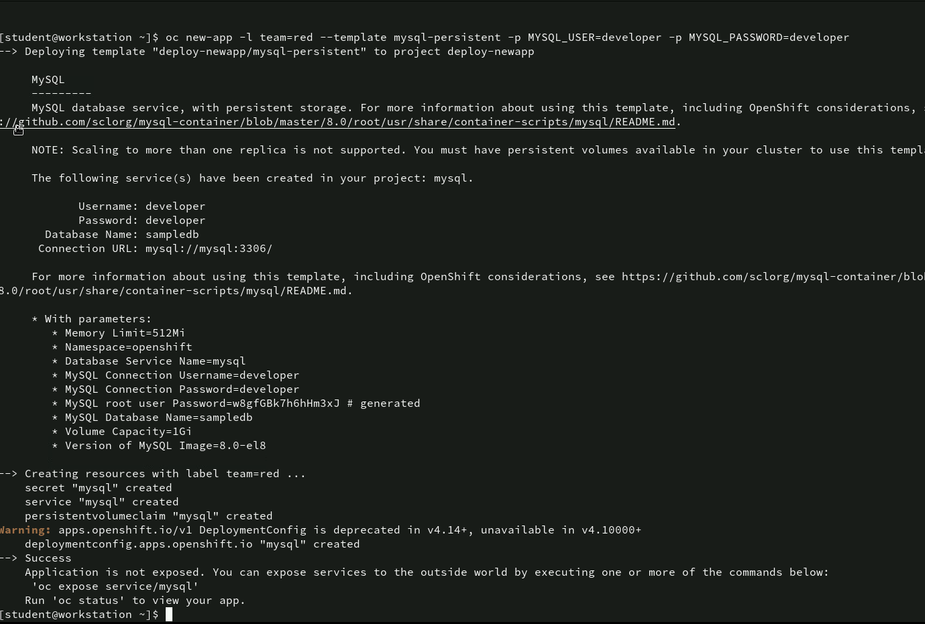
Command to deploy application using OpenShift Template: oc new-app
This command creates a new application in OpenShift using the `mysql-persistent` template. It passes several parameters to configure the MySQL database instance. The label `team=red` is also added to help organize or identify this deployment.
Template Information: The template being used is for deploying MySQL with persistent storage. The resources created include a secret, service, volume claim, and deployment configuration.

Slide 22
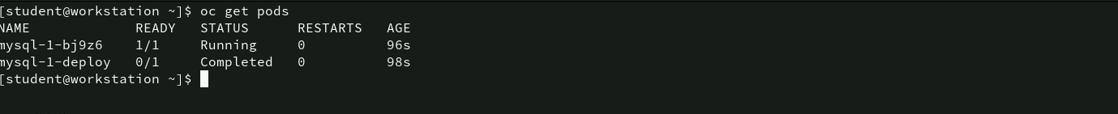
Command to get pods deployment information : oc get pods
- The oc get pods command is used to list the status of pods in the OpenShift project. On Pod is in running state whereas the other in completed one.

Slide 23
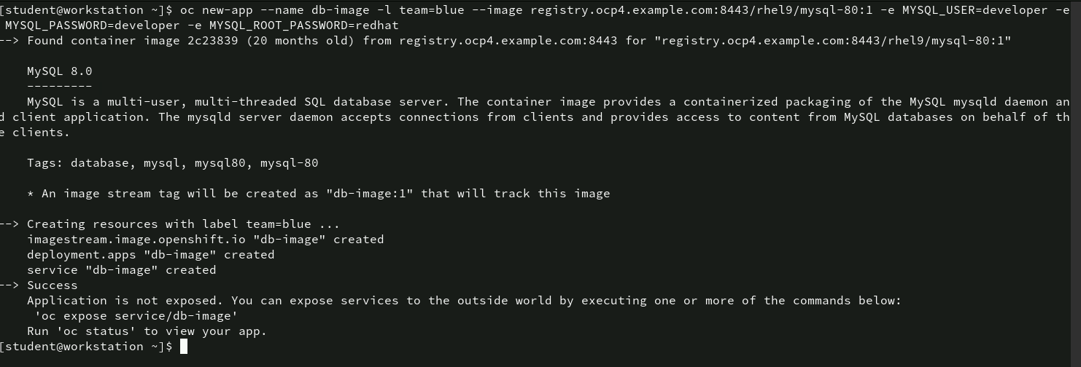
Command for application using image stream : oc new-app
- This command creates a new application in OpenShift using the MySQL 8.0 container image. The environment are set for the MySQL instance. The label team=blue is also added to the resources for easy identification. The output provides information about the MySQL 8.0 image, its tags, and the resources being created: An image stream tag db-image:1 is created to track the MySQL image. A deployment and service named “db-image” are created.

Slide 24
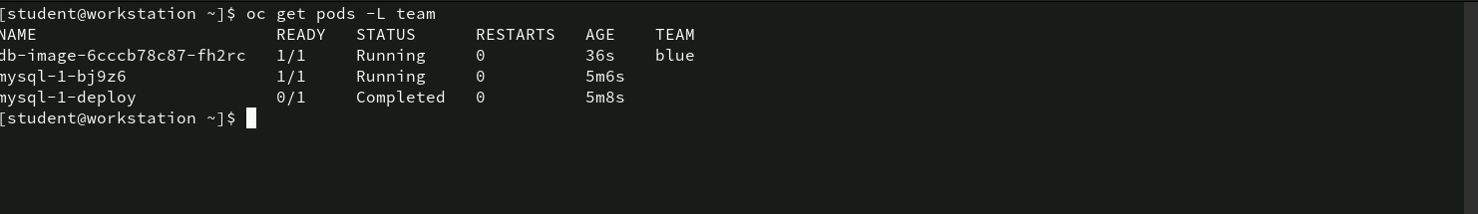
Command for viewing Pods : oc get pods
oc get pods -L team is used to retrieve a list of pods in an OpenShift cluster. The -L team flag instructs the system to display the label named “team” for each pod.
In this case, there are three pods listed, with two running and one completed. The first pod belongs to the “blue” team, while the others don’t seem to have a label value under the “TEAM” column. This command helps in monitoring the status of pods and organizing them based on labels.

Slide 25
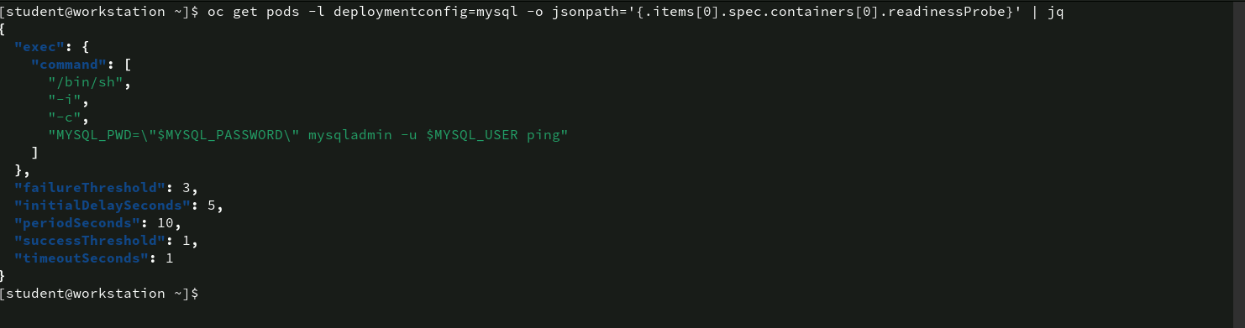
Command for extracting Readiness [Probe Information using jq
The command is used to extract the readiness probe details of the first container in a pod associated with the mysql deployment configuration.
The use of jq at the end formats the JSON output for better readability.

Slide 26
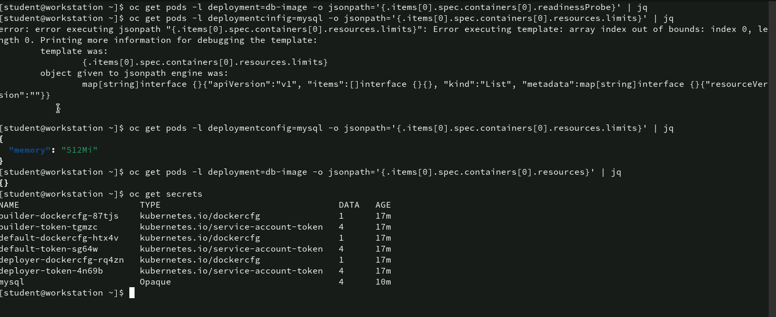
Command for inspecting Pod resource limits and secrets
The command executed successfully retrieves the memory resource limit of the MySQL container, which is set to 512Mi. This indicates that the container has a memory limit of 512 MiB.
oc get secrets: This command lists all secrets available in the current namespace. The output shows various secrets like Docker configurations and service account tokens, with their names, types, data sizes, and age. One specific secret, labeled “mysql,” likely stores sensitive data related to the MySQL database such as credentials.

Slide 27
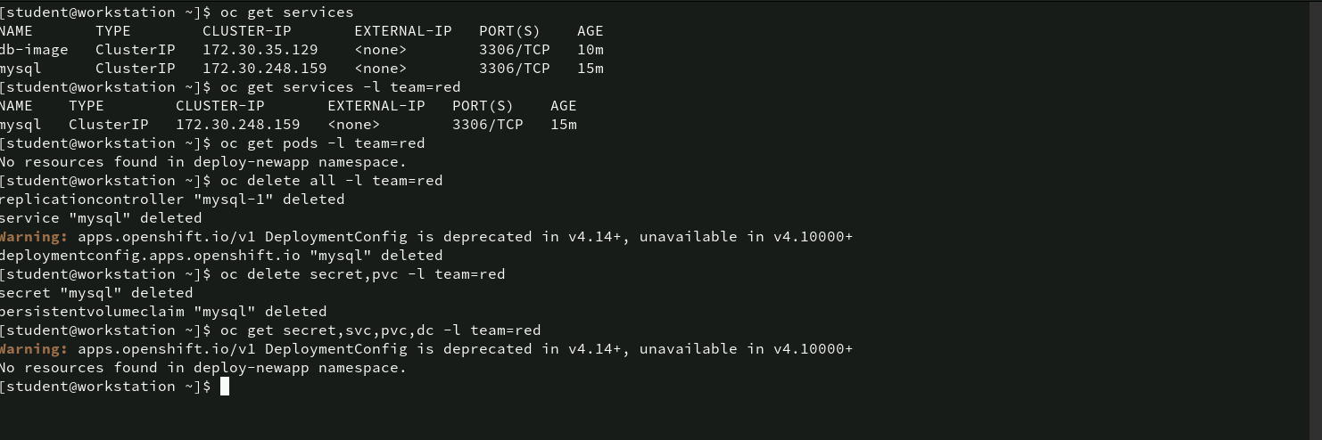
Command for for managing services, pods, and resources
These commands show how to manage and clean up resources in OpenShift using labels (in this case, “team=red”). The resources such as services, secrets, and PVCs were listed, filtered, and deleted based on their labels. Additionally, the screenshot highlights warnings about the deprecation of DeploymentConfig in future OpenShift versions, suggesting that future deployments should use newer resource types.

Slide 28
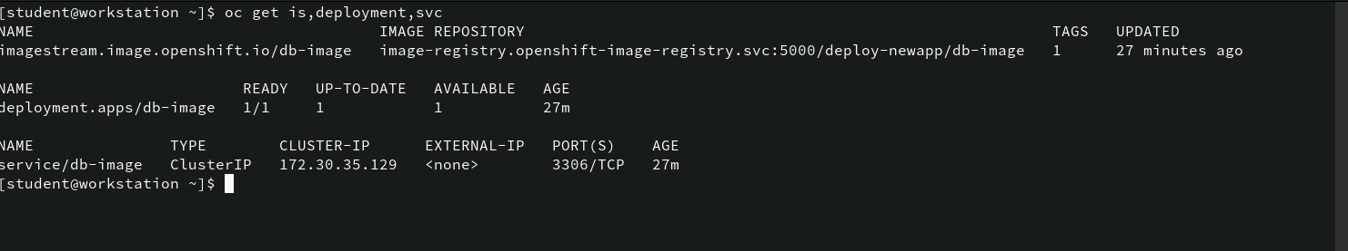
Command to view Image streams, deployments, and services
The command helps monitor the status of the image stream, deployment, and service related to the db-image application in the OpenShift cluster. The service is exposing the MySQL database internally within the cluster on port 3306, and everything is functioning as expected with the deployment having 1 pod running.

Slide 29
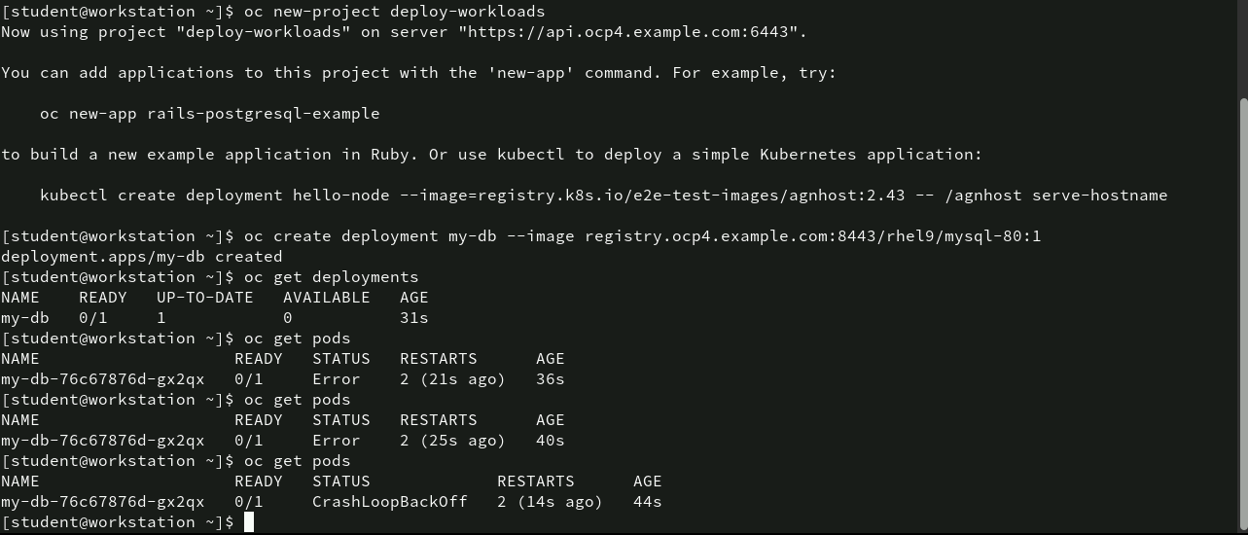
Command for creating and managing MySQL Deployment
oc new-project deploy-workloads: This command creates a new OpenShift project called deploy-workloads and sets the project as the active context.
oc create deployment my-db --image registry.ocp4.example.com:8443/rhel9/mysql-80:1: This command creates a new deployment named my-db using a MySQL image from the specified registry.

Slide 30
Command for creating and managing MySQL Deployment
oc get deployments: This command shows the status of the deployment my-db. It shows that the deployment is not ready (0/1 pods are ready) even though one pod has been created, and the deployment is not yet available for use.
oc get pods: This command lists the pods under the my-db deployment. The pod my-db-76c67876d-gx2qx has encountered an error. The pod still shows an error (0/1 READY), and it has now been running for 40 seconds with multiple restarts (2 restarts), indicating continuous failure. After a few more seconds, the pod enters a CrashLoopBackOff state, which means the pod is continuously crashing and restarting. This is typically due to an issue with the container, such as a missing environment variable, wrong configuration, or a failed startup script.

Slide 31
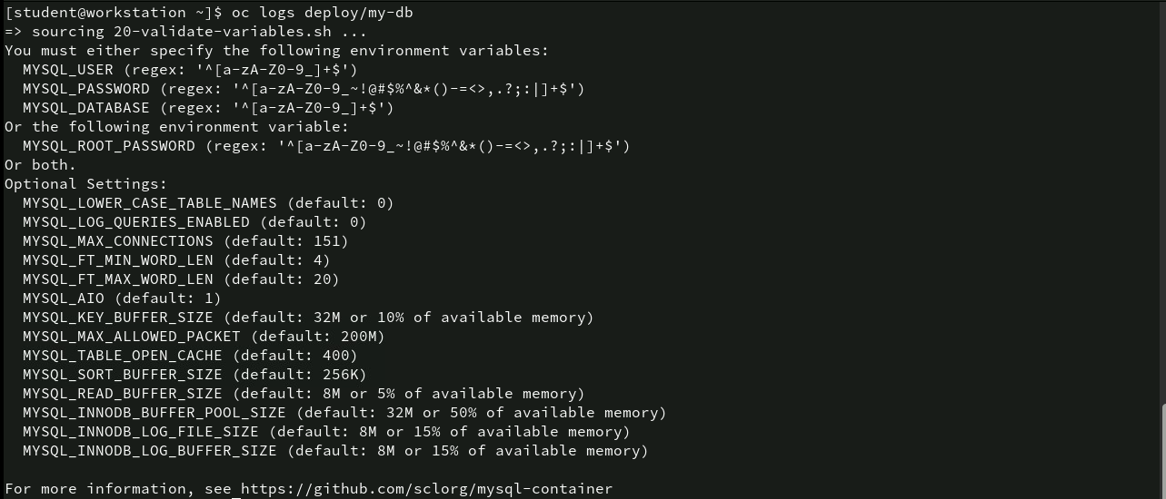
Command for troubleshooting Deployment Logs: oc logs
The log output clearly points to missing environment variables as the cause of the deployment failure. To fix this issue, you need to set the required environment variables (MYSQL_USER, MYSQL_PASSWORD, MYSQL_DATABASE, or MYSQL_ROOT_PASSWORD) in the deployment configuration. Once these variables are set, the MySQL container should start properly, avoiding the CrashLoopBackOff state.

Slide 32
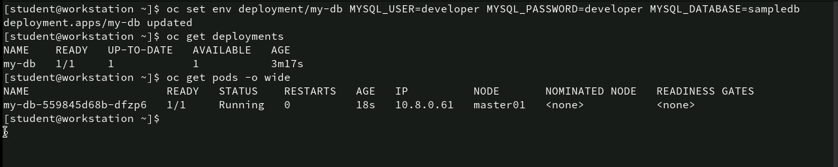
Command for setting environment variables for the deployment: oc set env
The environment variables (MYSQL_USER, MYSQL_PASSWORD, and MYSQL_DATABASE) were successfully set for the my-db deployment, resolving the previous startup issue. The deployment is now running properly with 1 pod in a healthy state. This confirms that the MySQL container is correctly configured and operational within the OpenShift environment.

Slide 33
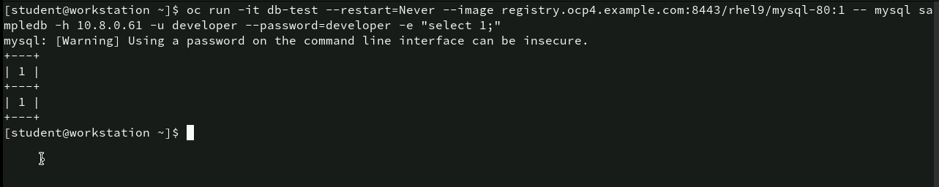
Command for running sql commands inside a test pod: oc run -it
This command creates a temporary pod to test the connection to the MySQL database running on 10.8.0.61. The query select 1; runs successfully, confirming that the MySQL server is functioning and accessible with the given credentials.

Slide 34
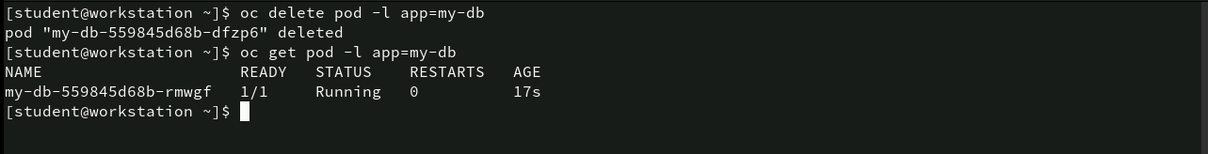
Command for deleting and recreating a pod: oc delete, oc get
oc delete pod -l app=my-db: This command deletes the pod with the label app=my-db. In this case, the pod my-db-559845d68b-dfzp6 is deleted. Since this pod is part of a managed deployment (my-db), OpenShift will automatically recreate a new pod to maintain the desired state of 1 running pod for the deployment.
oc get pod -l app=my-db: This command retrieves the pods labeled app=my-db after the deletion. A new pod, my-db-559845d68b-rmwgf, is now running with 1/1 containers ready and 0 restarts. The pod has been running for only 17 seconds, indicating that it was recreated shortly after the previous pod was deleted.

Slide 35
Command for creating job to run a loop: oc create job
oc create job date-loop: This creates a job named date-loop. A job in Kubernetes/OpenShift ensures that a specified task is completed, and it can run one or more pods until the job is finished.
--image registry.ocp4.example.com:8443/ubi9/ubi: Specifies the Universal Base Image (UBI) from the specified registry (ubi9/ubi). This image will be used to run the job.
/bin/bash -c "for i in {1..30}; do date; done": This is the command that will be executed inside the container. It runs a loop that prints the current date 30 times.

Slide 36
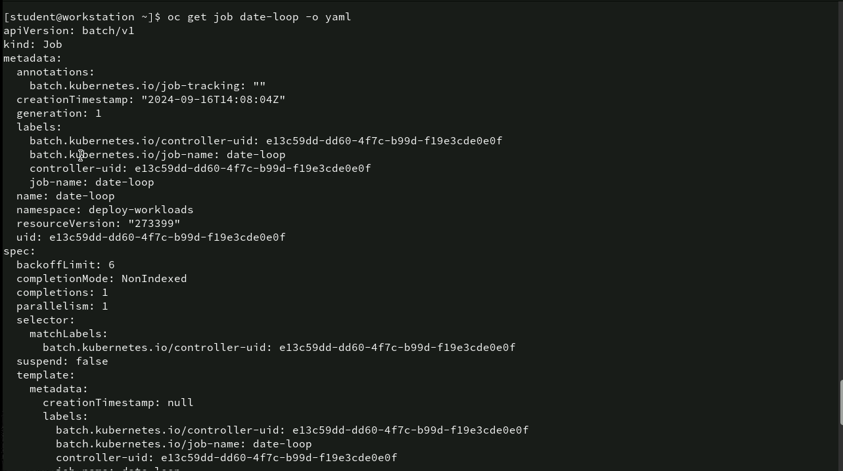
Command for inspecting a job: oc get job
The YAML output provides detailed configuration for the date-loop job, including its metadata, backoff limit, completion, and pod template. This YAML structure is useful for understanding the job’s lifecycle and how OpenShift will manage the execution of the job’s pod

Slide 37
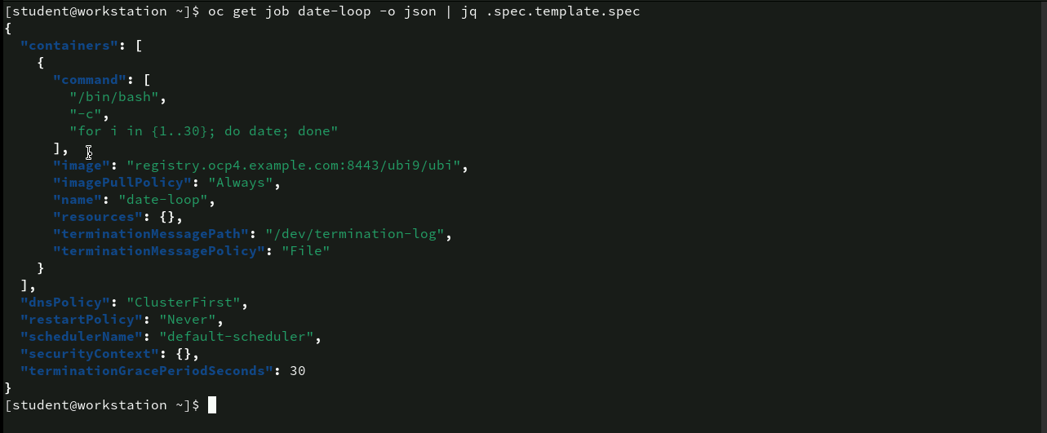
Command for inspecting job template in JSON format: oc get job
This JSON output provides a clear view of how the pod within the date-loop job is configured. It runs a simple date-printing command using the UBI image and has policies set for DNS, restarts, and termination handling. This information is useful for understanding the lifecycle of the pod and how it behaves during and after its execution within the job’s context in OpenShift.

Slide 38
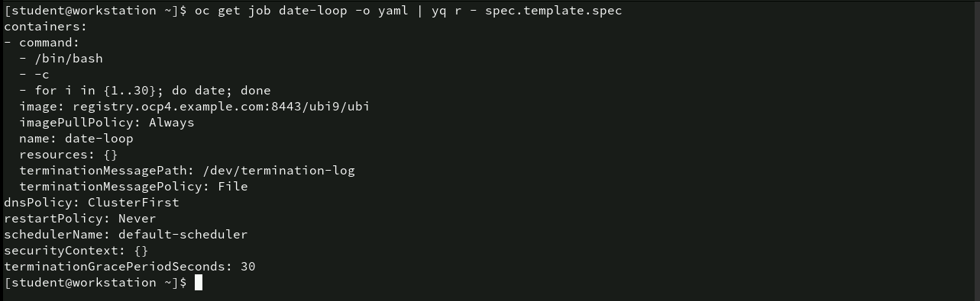
Command for inspecting job template using YAML: oc get job
This YAML format provides a detailed configuration of the pod template that is part of the date-loop job. The pod will run the date command in a loop and will be configured with typical job settings, such as not restarting once completed and a 30-second termination grace period.

Slide 39
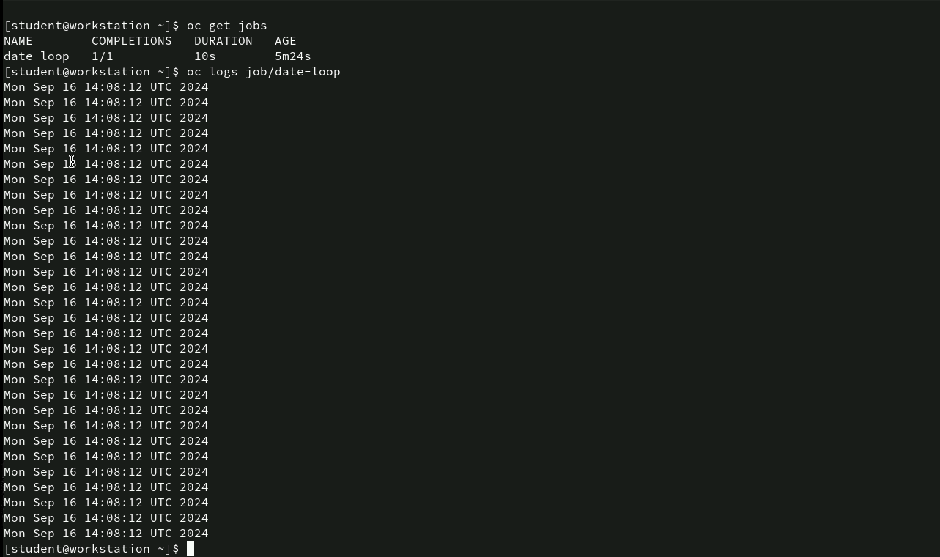
Command for verifying job completion and viewing logs: oc get jobs, oc get logs
oc get jobs: This command lists the jobs running in the current namespace. The output shows the job date-loop has completed. The job took 10 seconds to complete. The job has been running for 5 minutes and 24 seconds since it was created.
oc logs job/date-loop: This command retrieves the logs of the date-loop job. The logs show the output of the command that was run inside the job, which is the date command executed 30 times.

Slide 40
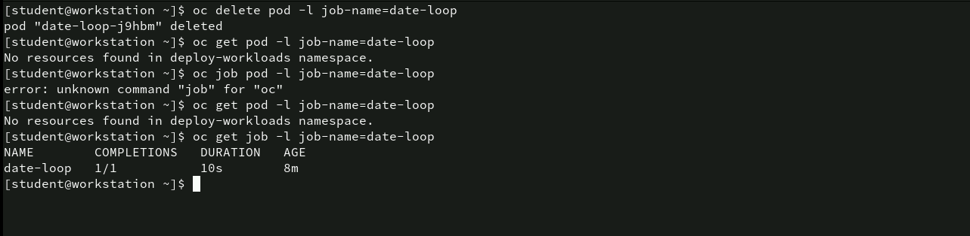
Command for deleting and inspecting job resources
oc delete pod -l job-name=date-loop: This command deletes the pod associated with the job date-loop. The pod date-loop-j9hbm is successfully deleted.
oc get pod -l job-name=date-loop: This command checks for any remaining pods with the label job-name=date-loop. The output indicates that no resources (pods) are found in the deploy-workloads namespace, confirming that the pod was successfully deleted.
oc get job -l job-name=date-loop: This command retrieves the status of the job date-loop. The job is complete with 1/1 completions, took 10 seconds to execute, and is now 8 minutes old.

Slide 41
Command for creating. And configuring MySQL Deployment: oc create deployment, oc set env
The screenshot demonstrates the creation of a MySQL deployment in OpenShift using the MySQL 8 image and exposes the service on port 3306. Additionally, it configures the necessary environment variables (MYSQL_USER, MYSQL_PASSWORD, and MYSQL_DATABASE) to initialize the MySQL database for the deployment. The deployment is now set up and ready to run a MySQL service with the specified configuration.

Slide 42
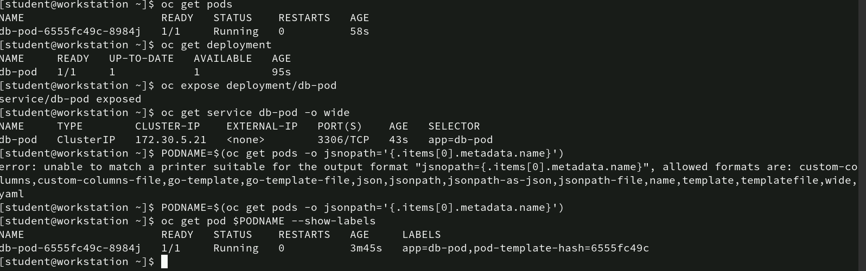
Command for managing Pods and exposing MySQL Deployment
oc get pods: This command lists the running pods.
oc get deployment: This command checks the status of the db-pod deployment. The deployment is ready, with 1 pod up-to-date and available, and the deployment has been running for 95 seconds.
oc expose deployment/db-pod: This command exposes the db-pod deployment as a service, making it accessible via a ClusterIP. The service is successfully exposed.

Slide 43
Command for managing Pods and exposing MySQL Deployment
oc get service db-pod -o wide: This command retrieves detailed information about the db-pod service. It is of type ClusterIP, with the IP 172.30.5.21 and port 3306/TCP, which is typically used for MySQL.
PODNAME=$(oc get pods -o jsonpath='{.items[0].metadata.name}’): It extracts the name of the first pod and stores it in the PODNAME variable.
oc get pod $PODNAME --show-labels: This command retrieves the pod with the name stored in the PODNAME variable and displays its labels. The pod is still running, and the labels show app=db-pod and a pod template hash (pod-template-hash=6555fc49c).

Slide 44
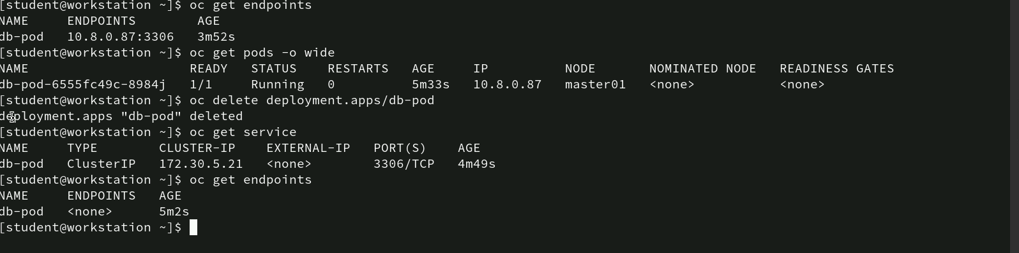
Command for delete a deployment and managing endpoints
oc get endpoints: This command retrieves the endpoints for the db-pod service. The endpoint 10.8.0.87:3306 is shown, indicating that the service is connected to the MySQL pod running on port 3306.
oc get pods -o wide: This command lists the pods in the current namespace with extended information. The pod db-pod-6555fc49c-8984j is running, with 1 container ready and no restarts.
oc delete deployment.apps/db-pod: This command deletes the db-pod deployment. The output confirms that the deployment has been successfully deleted.

Slide 45
Command for delete a deployment and managing endpoints
oc get service: After deleting the deployment, this command checks the service db-pod. The service is still present with a ClusterIP of 172.30.5.21 and is listening on port 3306/TCP.
oc get endpoints (again): This command checks the endpoints for the db-pod service after the deployment has been deleted. No endpoints are found, as the pod has been removed, and the service is no longer linked to an active pod.

Slide 46
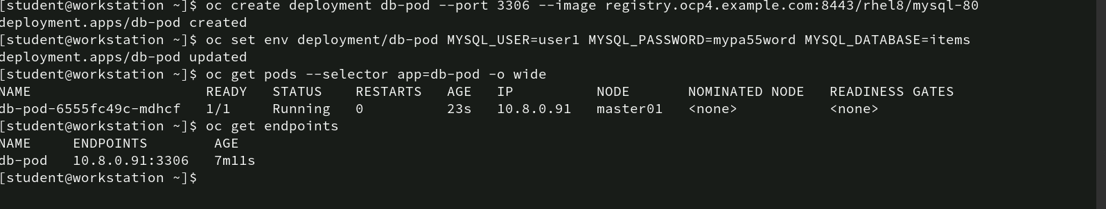
Commands for recreate and configuring Deployment
This sequence shows the successful recreation of the MySQL deployment in OpenShift. The db-pod is created with the necessary environment variables for MySQL, including user, password, and database. The pod is running on node master01, and the service has successfully created an endpoint (10.8.0.91:3306), allowing access to the MySQL database. This confirms that the MySQL service is up and running with the correct configuration.

Slide 47
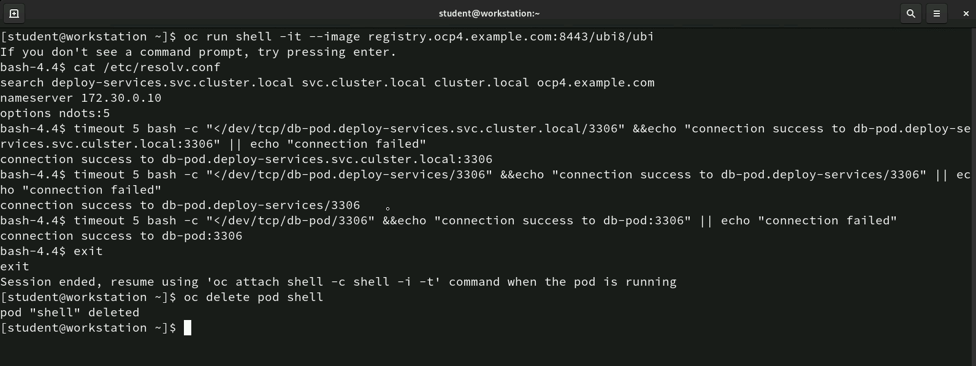
Commands for testing MySQL Service Connection from a Temporary Pod
oc run shell --it --image registry.ocp4.example.com:8443/ubi8/ubi: This command creates a temporary pod named shell using the Universal Base Image (UBI). The -it option allows interaction with the shell, meaning the user can run commands inside the pod.
cat /etc/resolv.conf: This command displays the pod’s DNS configuration. The output shows that the pod is using internal cluster DNS (172.30.0.10) with the search domains set for OpenShift’s internal services.

Slide 48
Commands for testing MySQL Service Connection from a Temporary Pod
timeout 5 bash -c "</dev/tcp/db-pod.deploy-services.svc.cluster.local/3306" && echo "connection success to db-pod.deploy-services.svc.cluster.local:3306" || echo "connection failed”: The command uses a TCP connection to db-pod.deploy-services.svc.cluster.local on port 3306, which corresponds to the MySQL service. The connection test is successful, confirming that the MySQL service is accessible from the pod.
Testing connection to the db-pod service directly: Another connection test is performed to the db-pod service on port 3306, using the service name db-pod.deploy-services/3306. Again, the connection is successful, confirming that the MySQL service is working correctly.
oc delete pod shell: This command deletes the temporary shell pod, cleaning up resources after testing.

Slide 49
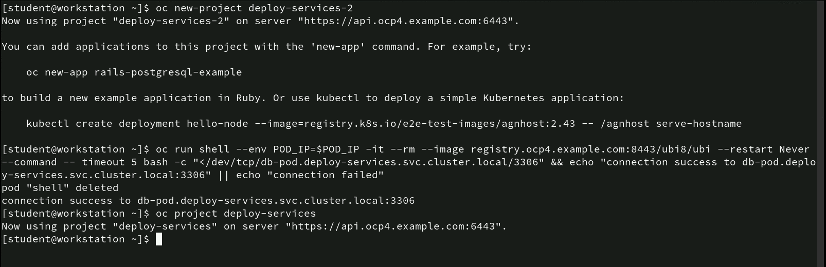
Command for creating a new project and testing service connectivity
oc new-project deploy-services-2: This command creates a new project named deploy-services-2 and switches the active context to this new project.

Slide 50
Command for creating a new project and testing service connectivity
oc run shell --env POD_IP=$POD_IP -it --rm --image registry.ocp4.example.com:8443/ubi8/ubi --restart Never --command -- timeout 5 bash -c "</dev/tcp/db-pod.deploy-services.svc.cluster.local/3306" && echo "connection success to db-pod.deploy-services.svc.cluster.local:3306" || echo "connection failed”: There are a series of commands executed-
oc run shell: Creates a temporary pod named shell.
env POD_IP=$POD_IP: Passes an environment variable POD_IP.
-it --rm --image registry.ocp4.example.com:8443/ubi8/ubi --restart Never --command: Runs the ubi8 image with interactive terminal mode (-it), does not restart (--restart Never), and deletes the pod after execution (--rm).
timeout 5 bash -c "</dev/tcp/db-pod.deploy-services.svc.cluster.local/3306": Tests the connection to the db-pod MySQL service running on port 3306.
&& echo "connection success" || echo "connection failed": If the connection is successful, it outputs “connection success”; otherwise, it outputs “connection failed.”
oc project deploy-services: This command switches the current project context back to deploy-services. The user can now manage resources in the deploy-services project.

Slide 51
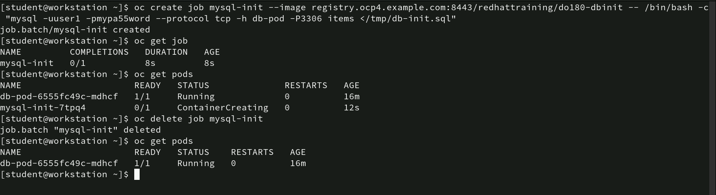
Command for creating and deleting MySQL Initialization Job
- oc create job mysql-init --image registry.ocp4.example.com:8443/redhattraining/do180-dbinit -- /bin/bash -c "mysql -uuser1 -pmypa55word --protocol tcp -h db-pod -P3306 items </tmp/db-init.sql”: This command creates a job named mysql-init to initialize the MySQL database:
• --image registry.ocp4.example.com:8443/redhattraining/do180-dbinit: Specifies the image used to run the job.
• /bin/bash -c "mysql -uuser1 -pmypa55word --protocol tcp -h db-pod -P3306 items </tmp/db-init.sql": This runs a MySQL command to initialize the items database using the user user1 and password mypa55word.

Slide 52
Command for creating and deleting MySQL Initialization Job
oc get job: This command checks the status of the job mysql-init
oc get pods: This command lists the pods, including the one created by the job (mysql-init-7tpq4), which is still in the “ContainerCreating” phase after 12 seconds.
oc delete job mysql-init: This command deletes the mysql-init job before it completes. The job is successfully deleted with the output: job.batch "mysql-init" deleted.
oc get pods: After deleting the job, this command lists the remaining pods. Only the MySQL pod (db-pod-6555fc49c-mdhcf) is running, confirming that the job-related pod has been removed.

Slide 53
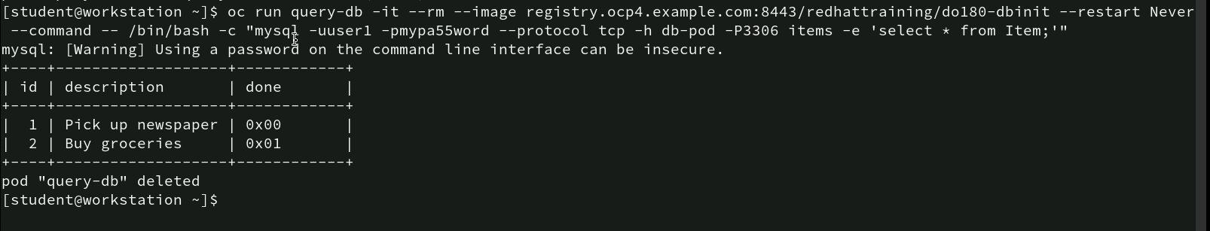
Commands for running MySQL Query Using temporary Pod
- oc run query-db -it --rm --image registry.ocp4.example.com:8443/redhattraining/do180-dbinit --restart Never --command -- /bin/bash -c "mysql -uuser1 -pmypa55word --protocol tcp -h db-pod -P3306 items -e 'select * from Item;'"
• oc run query-db: Creates a temporary pod named query-db.
• -it: Runs the pod in interactive mode with a terminal session.
• --rm: Automatically removes the pod after the command execution is completed.
• --image registry.ocp4.example.com:8443/redhattraining/do180-dbinit: Uses the do180-dbinit image for running MySQL commands.
• --restart Never: Specifies that the pod should not restart if it completes or fails.
• --command -- /bin/bash -c "mysql -uuser1 -pmypa55word --protocol tcp -h db-pod -P3306 items -e 'select * from Item;'": Executes a MySQL query (select * from Item;) against the items database hosted on the db-pod MySQL instance.
The query successfully retrieves data from the Item table in the items database.

Slide 54
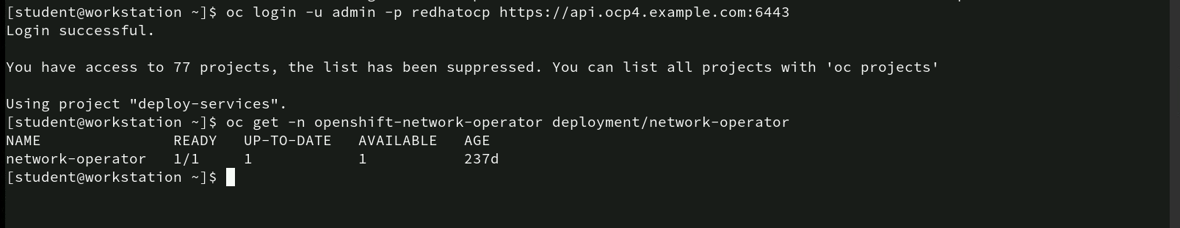
Commands for checking Network Operator Deployment
oc login -u admin -p redhatocp https://api.ocp4.example.com:6443: This command logs the user into the OpenShift cluster using the username admin and the password redhatocp.
oc get -n openshift-network-operator deployment/network-operator: This command checks the status of the network-operator deployment in the openshift-network-operator namespace.

Slide 55
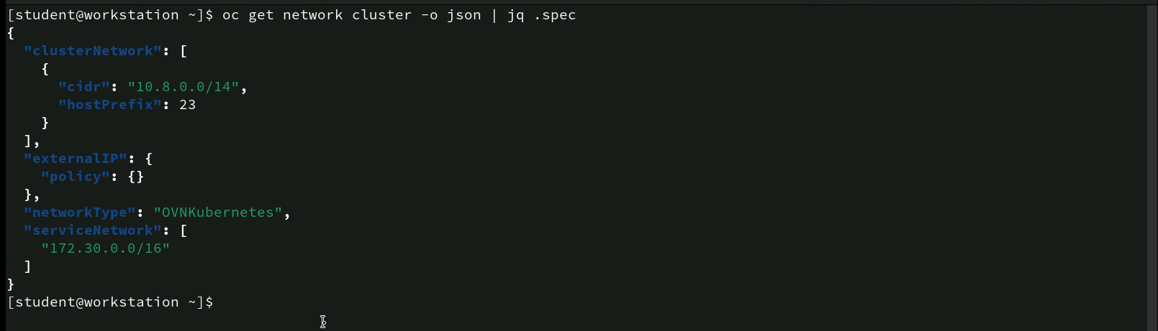
Commands for diagnosing Image Pull Failure
- oc get network cluster -o json | jq .spec: This command retrieves the network configuration for the OpenShift cluster in JSON format and filters the output to show only the spec field using jq.
The cluster uses a 10.8.0.0/14 CIDR block for pod networking and a /23 subnet for each node. The service network is configured to use the 172.30.0.0/16 range, and the cluster is utilizing the OVNKubernetes network plugin.

Slide 56
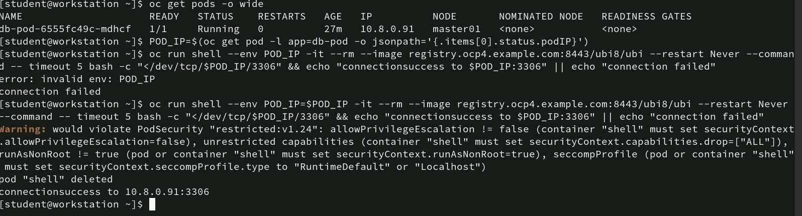
Commands for Testing Connection to a Pod
oc get pods -o wide: This command lists all the pods in the current namespace with extended details, including the pod’s IP address and node assignment.
POD_IP=$(oc get pod -l app=db-pod -o jsonpath='{.items[0].status.podIP}’): This command extracts the IP address of the pod labeled app=db-pod and stores it in the environment variable POD_IP.
oc run shell --env POD_IP=$POD_IP -it --rm --image registry.ocp4.example.com:8443/ubi8/ubi --restart Never --command -- timeout 5 bash -c "</dev/tcp/$POD_IP/3306" && echo "connectionsuccess to $POD_IP:3306" || echo "connection failed”: the connection to the MySQL pod (10.8.0.91:3306) is successful, as shown by the output: connectionsuccess to 10.8.0.91:3306.

Slide 57
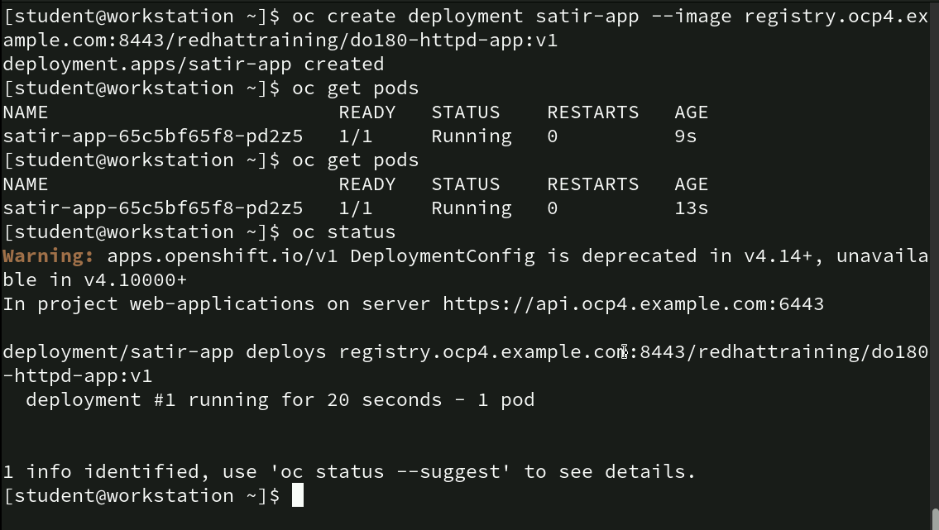
Commands for creating and managing an HTTP Application
oc create deployment satir-app --image registry.ocp4.example.com:8443/redhattraining/do180-httpd-app:v1: This command creates a new deployment named satir-app using the do180-httpd-app:v1 image, which is an HTTP server application.
oc get pods: The user runs the same command a few seconds later, and the pod has now been running for 13 seconds, still in a stable state with no restarts.
oc status: This command checks the overall status of the project and deployment.

Slide 58
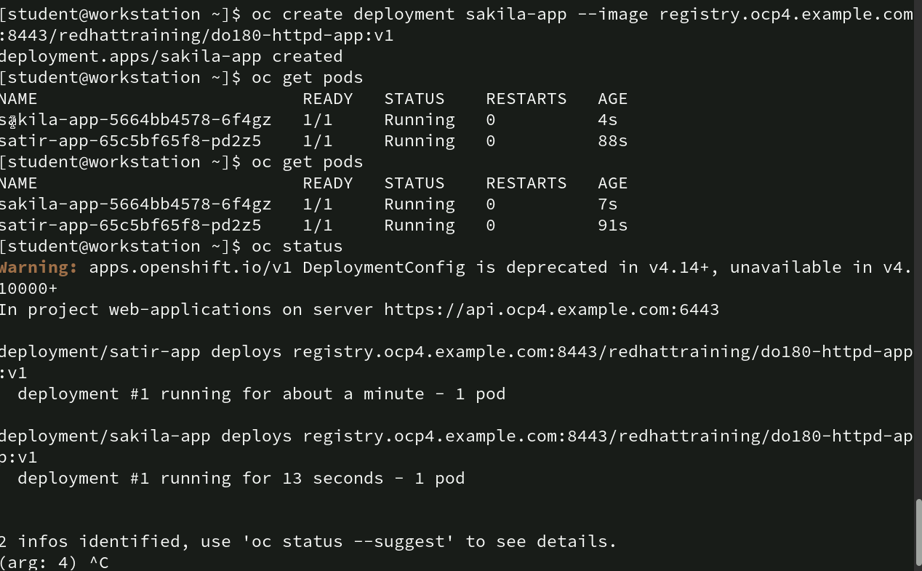
Commands for Creating Multiple Deployments and Checking Status
This screenshot demonstrates the creation and management of multiple deployments in OpenShift. Two HTTP-based applications, satir-app and sakila-app, are successfully deployed, and their statuses are checked. Both deployments are running without issues.

Slide 59
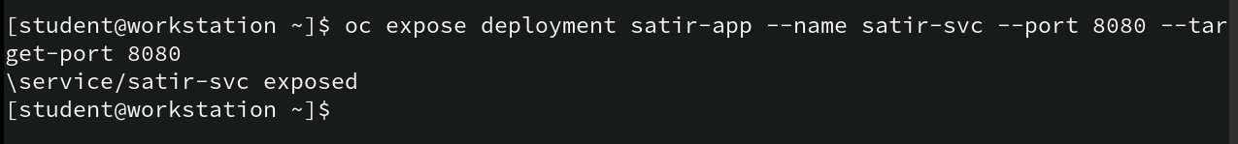
Commands for Exposing Deployment as a Service
- oc expose deployment satir-app --name satir-svc --port 8080 --target-port 8080
• oc expose deployment satir-app: This command creates a service for the satir-app deployment. It makes the application accessible within the cluster or externally, depending on the cluster configuration.
• --name satir-svc: This flag names the service satir-svc. A unique name for the service allows it to be referenced and managed easily.
• --port 8080: This defines the port on which the service will be exposed (in this case, port 8080).
• --target-port 8080: This specifies the port on the application (container) that the service should forward traffic to. In this case, both the service and the target application are using port 8080.

Slide 60
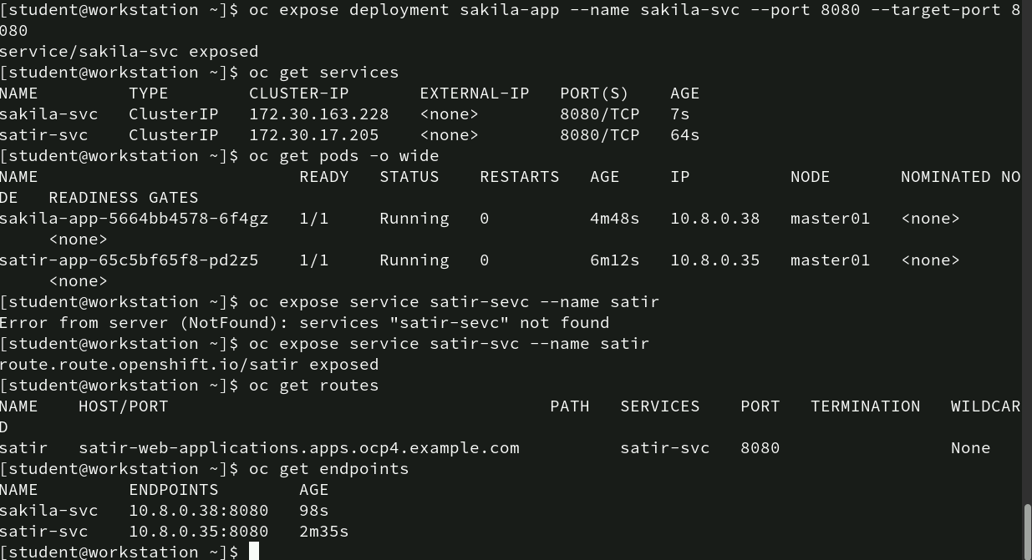
Commands for exposing Services and creating Routes
oc expose deployment sakila-app --name sakila-svc --port 8080 --target-port 8080: This command exposes the sakila-app deployment as a service named sakila-svc on port 8080.
oc get services: This command lists the services in the current namespace:

Slide 61
Commands for exposing Services and creating Routes
oc get pods -o wide: This command provides detailed information about the running pods:
• sakila-app is running on node master01 with the IP 10.8.0.38.
• satir-app is also running on node master01 with the IP 10.8.0.35.
oc expose service satir-svc --name satir: This command successfully exposes the satir-svc service with a route named satir. This route will make the service accessible externally.
oc get routes: The route exposes the service satir-svc on port 8080. The route can be accessed at satir-web-applications.apps.ocp4.example.com.
oc get endpoints: This command lists the endpoints for the services:
• sakila-svc: The endpoint is 10.8.0.38:8080, corresponding to the sakila-app pod.
• satir-svc: The endpoint is 10.8.0.35:8080, corresponding to the satir-app pod.

Slide 62
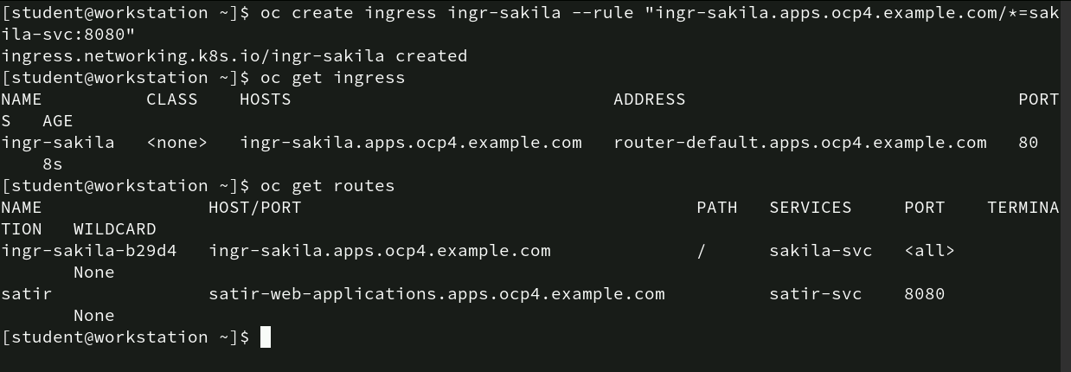
Commands for creating and managing Ingress and Routes
This example shows the creation of an ingress resource in OpenShift to manage traffic routing for the sakila-svc service. The ingress routes all traffic for the host ingr-sakila.apps.ocp4.example.com to the sakila-svc service on port 8080. Additionally, the list of routes shows both the new ingress route (ingr-sakila) and a previously created route for the satir-svc service. The ingress and routes make it easier to control and manage external traffic to services in the OpenShift cluster.

Slide 63
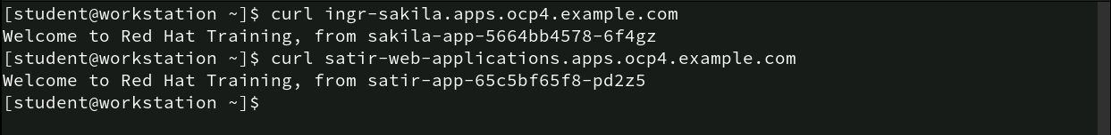
Commands for verifying application accessibility using Curl
curl ingr-sakila.apps.ocp4.example.com: This command sends a curl request to the URL ingr-sakila.apps.ocp4.example.com, which is the host managed by the ingress for the sakila-app. The response received confirms that the ingress is routing traffic correctly to the sakila-app pod (5664bb4578-6f4gz).
curl satir-web-applications.apps.ocp4.example.com: This command sends a curl request to the URL satir-web-applications.apps.ocp4.example.com, which is the route created for the satir-app. The response received confirms that route is successfully directing traffic to the satir-app pod (65c5bf65f8-pd2z5).

Slide 64
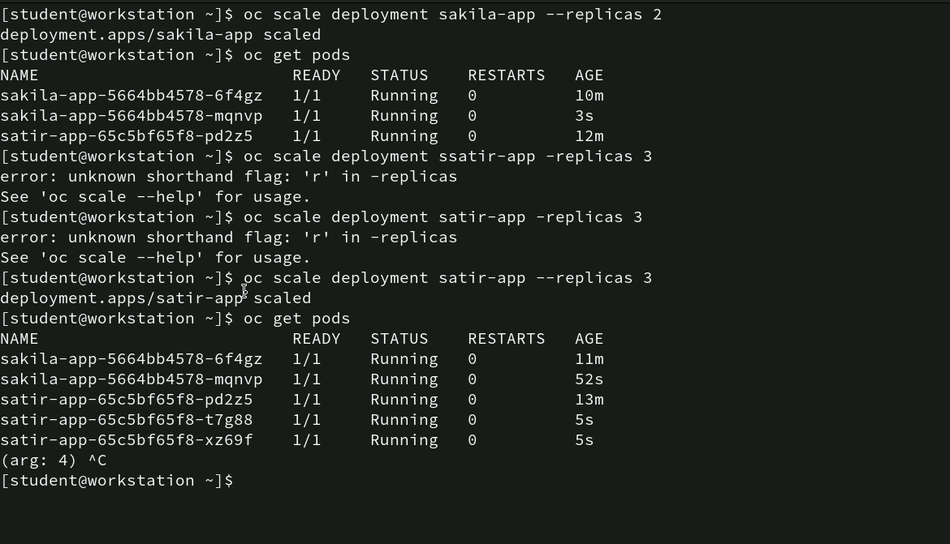
Commands for scaling Deployments
oc scale deployment sakila-app --replicas 2: This command scales the sakila-app deployment to 2 replicas (i.e., two running pods).
oc get pods: After scaling, this command lists the pods in the namespace. Two sakila-app pods are now running.
oc scale deployment satir-app --replicas 3: The command is executed to scale the satir-app deployment to 3 replicas.
oc get pods: After scaling, this command lists the updated pods.

Slide 65
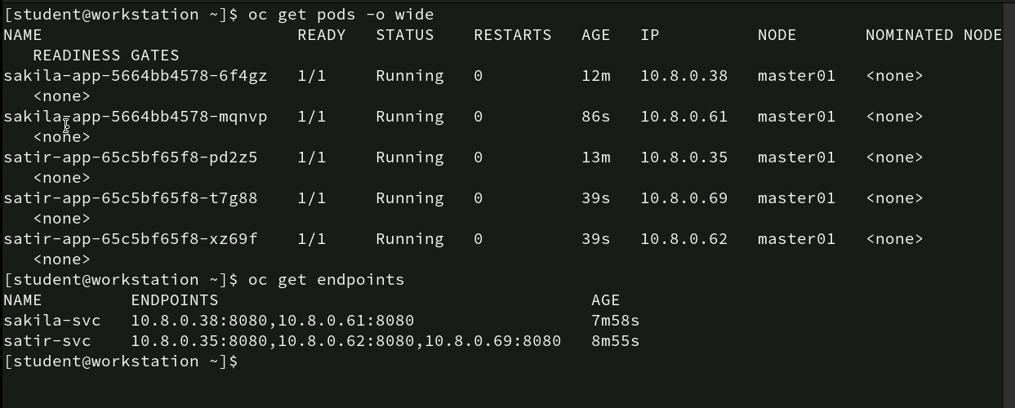
Commands for verifying Pod status and endpoints
- oc get pods -o wide: This command lists all the pods in the current namespace, providing additional details such as the IP address and node on which they are running.
oc get endpoints: This command shows the service endpoints for sakila-svc and satir-svc, including the IPs and ports for the associated pods.

Slide 66
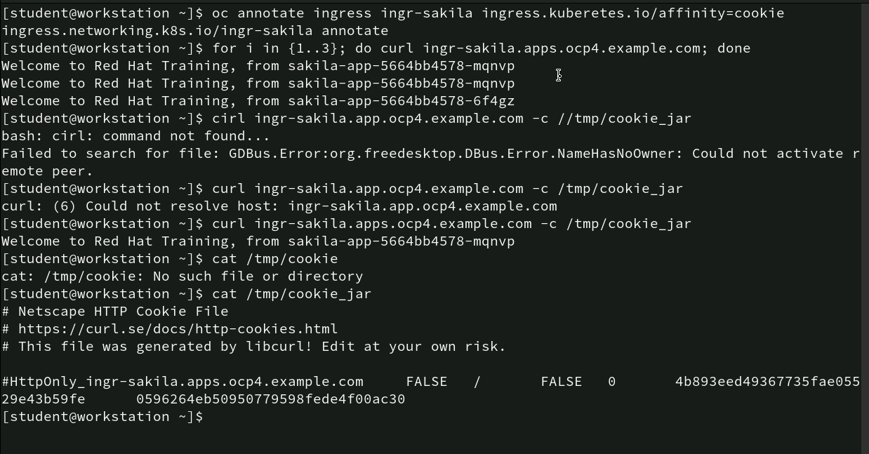
Commands for setting and verifying sticky session
oc annotate ingress ingr-sakila ingress.kubernetes.io/affinity=cookie: This command sets the session affinity (also known as sticky sessions) to cookie for the ingress named ingr-sakila. The annotation ingress.kubernetes.io/affinity=cookie ensures that once a client connects to a pod, all subsequent requests from the same client will be routed to the same pod based on a cookie.
Loop with curl Requests: The user runs a loop to make multiple curl requests to the ingr-sakila.apps.ocp4.example.com endpoint. The output shows that each request is routed to different sakila-app pods.

Slide 67
Commands for setting and verifying sticky session
curl ingr-sakila.apps.ocp4.example.com -c /tmp/cookie_jar: The output shows a successful request to sakila-app-5664bb4578-mqnvp.
cat /tmp/cookie_jar: The command shows stored cookie using the cat command.
The cookie stored in /tmp/cookie_jar can be used to ensure that subsequent requests from the same client are consistently routed to the same pod, improving user experience by maintaining session persistence.

Slide 68
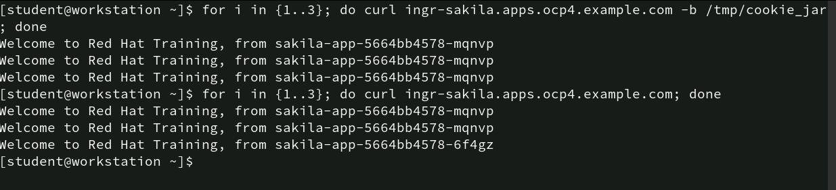
Commands for verifying cookie sessions
This screenshot confirms that cookie-based session affinity is functioning correctly. When using a cookie stored in /tmp/cookie_jar, all requests are routed to the same pod, ensuring that the user session remains consistent. Without the cookie, requests are routed to different pods, following the default load-balancing behavior. This is particularly useful for applications that rely on session persistence.

Slide 69
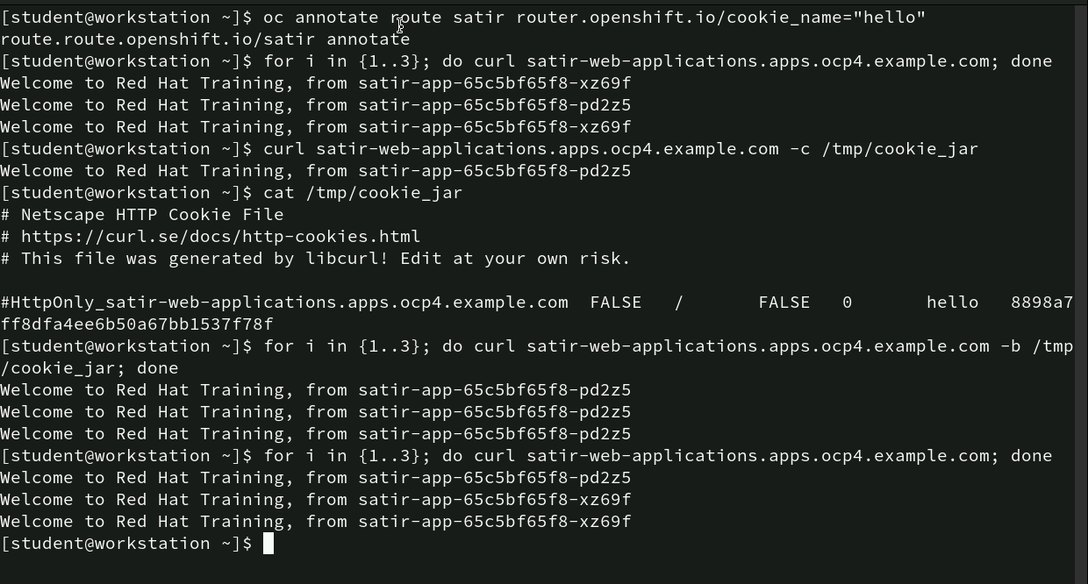
Commands for enabling session stickiness using custom cookie
By annotating the route with a custom cookie name (hello), the user was able to configure OpenShift to use cookie-based session stickiness. When the cookie is used, all requests from the same client are routed to the same pod. Without the cookie, requests are distributed across different pods, following the default load-balancing behavior. This configuration is particularly useful for maintaining consistent user sessions in applications.

Slide 70
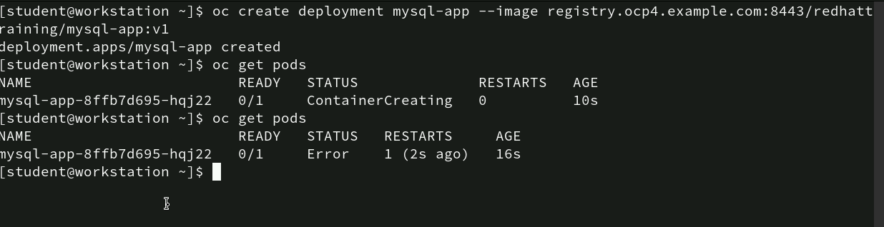
Commands for creating new deployment
First, the command oc create deployment mysql-app --image registry.ocp4.example.com:8443/redhattraining/mysql-app:v1 is used to create a deployment called “mysql-app” using a specified MySQL image from the registry.
After the deployment is created, the oc get pods command is run to check the status of the pod associated with the deployment. Initially, the pod’s status is “ContainerCreating,” indicating the pod is in the process of being started.
Upon running oc get pods again after a few seconds, the pod shows a status of “Error,” meaning the container failed to start successfully, and it has restarted once.

Slide 71
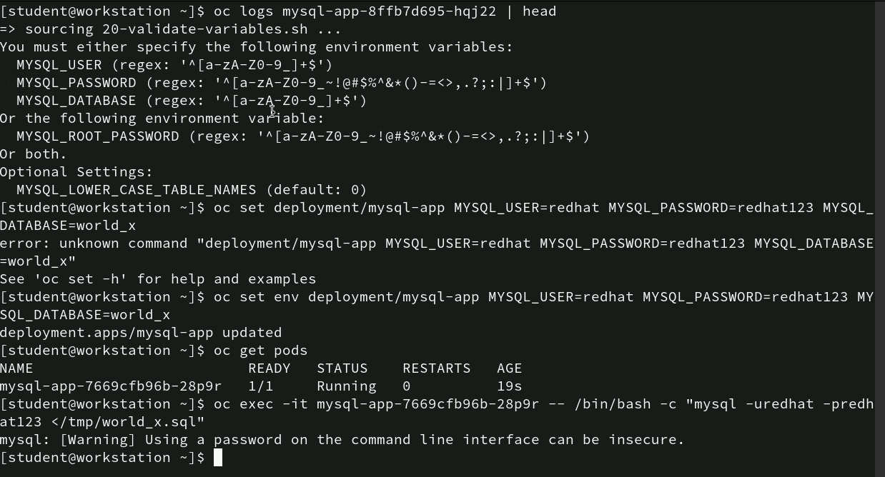
Commands for resolving pod env variables issues
In this session, errors in a MySQL deployment is observed on OpenShift by setting necessary environment variables (`MYSQL_USER`, `MYSQL_PASSWORD`, and `MYSQL_DATABASE`) after encountering issues in the pod logs.
The user then executes an SQL script inside the running pod, with a warning regarding the security risk of using passwords on the command line.

Slide 72

Commands for exposing MySQL service
In this screenshot, MySQL application deployment is exposed to make it accessible within the OpenShift cluster. The command oc expose deployment mysql-app --name mysql-service --port 3306 --target-port 3306 is used to create a service named “mysql-service” that forwards traffic from port 3306 on the service to port 3306 on the MySQL pod.
After running the command, the output confirms that the service has been successfully exposed, making the MySQL app accessible at the defined port.

Slide 73

Commands for deploying and exposing PHP application
In this screenshot, creating and exposing a PHP application on an OpenShift cluster is done. The process starts with the command oc create deployment php-app --image registry.ocp4.example.com:8443/redhattraining/php-webapp:v1 to create a deployment named “php-app” using the specified PHP web application image.
After the deployment is created, the user exposes it using oc expose deployment php-app --name php-svc --port 8080 --target-port 8080, which creates a service named “php-svc” that listens on port 8080.
The command oc expose service/php-svc --name=phpapp is used to create a route, making the service accessible externally via a URL. The oc get routes command then displays the route details, showing that the PHP app is accessible through the domain phpapp-database-applications.apps.ocp4.example.com on port 8080.

Slide 74

Successful PHP Application Connection
In this screenshot, the PHP application exposed on OpenShift is successfully running and connected to a database, as indicated by the message “Connected successfully.” The page displays a list of cities with their respective country codes, regions, and population data in JSON format.

Slide 75
Thank You!

